Slide 1
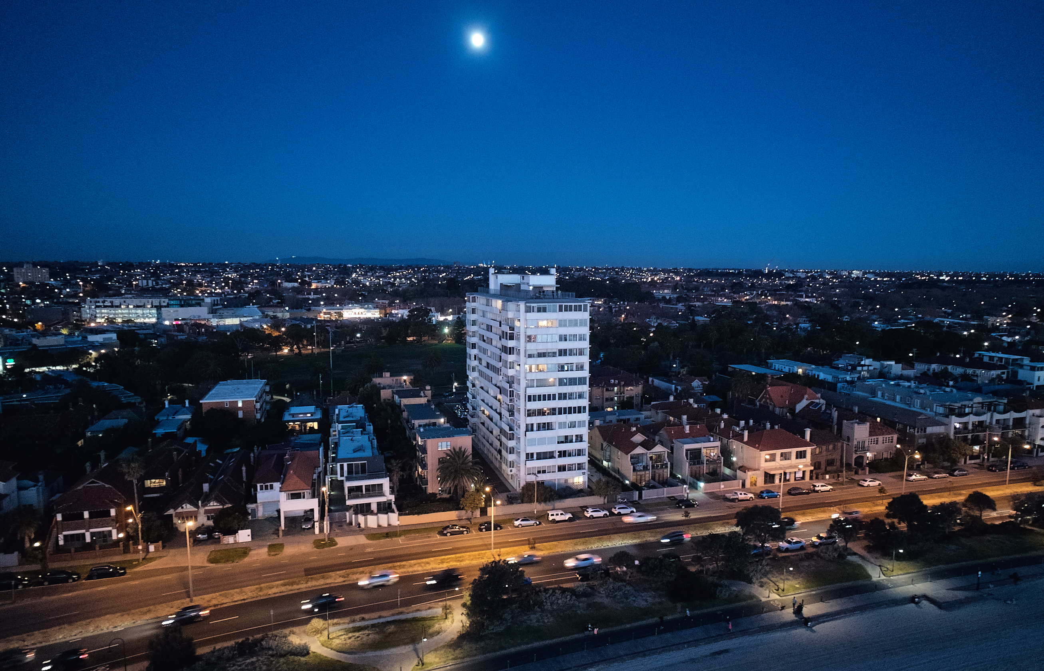
2025 Annual General Meeting
Registration of Attendance
PLEASE SIGN IN
Image Credit: Peter Bennetts – with permission

Slide 2
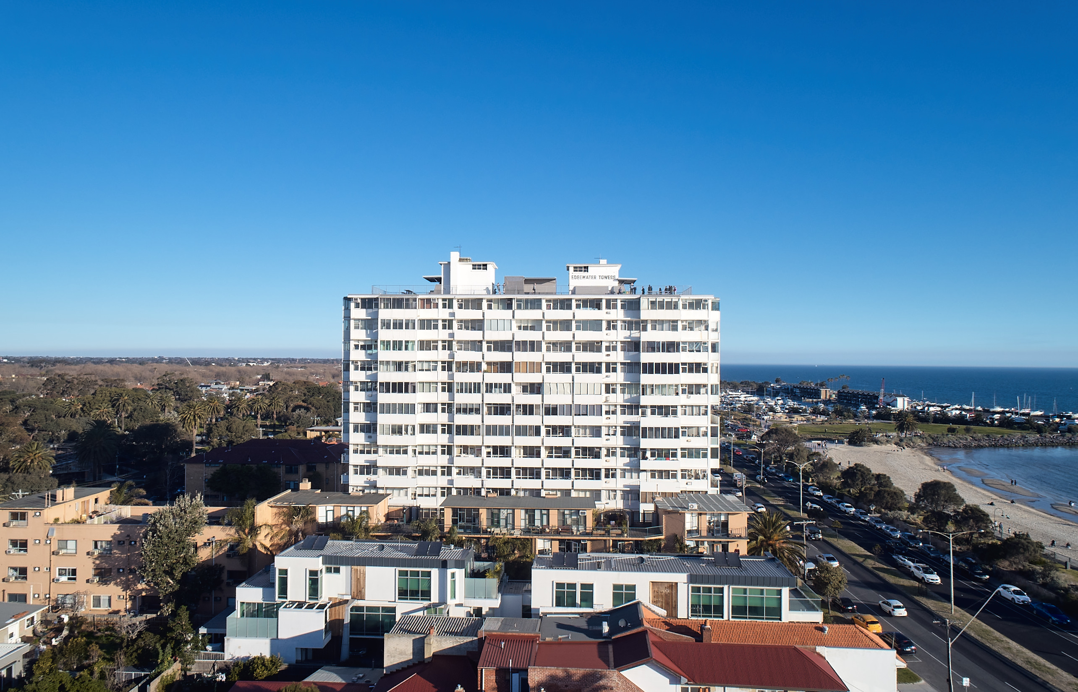
2. Voting Procedure
Image Credit: Peter Bennetts – with permission

Slide 3
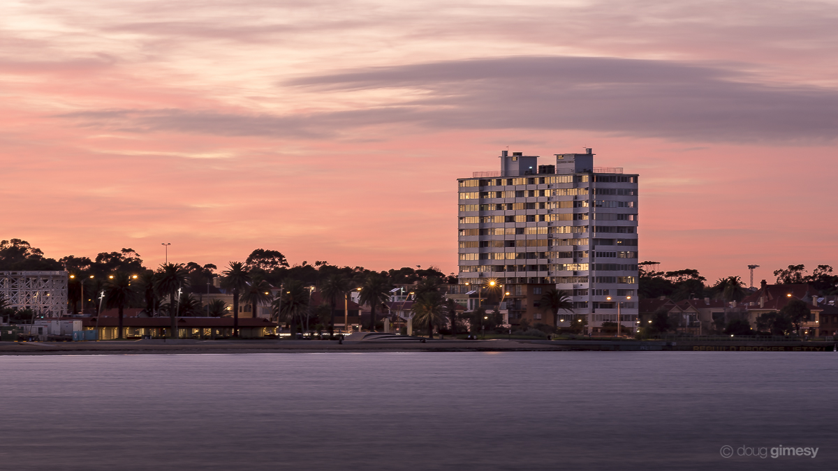
3. Adoption of Meeting Rules
Image Credit: Doug Gimesy Conservation and Wildlife Photography

Slide 4
4. Appointment of Chair
Image Credit: Peter Bennetts – with permission

Slide 5
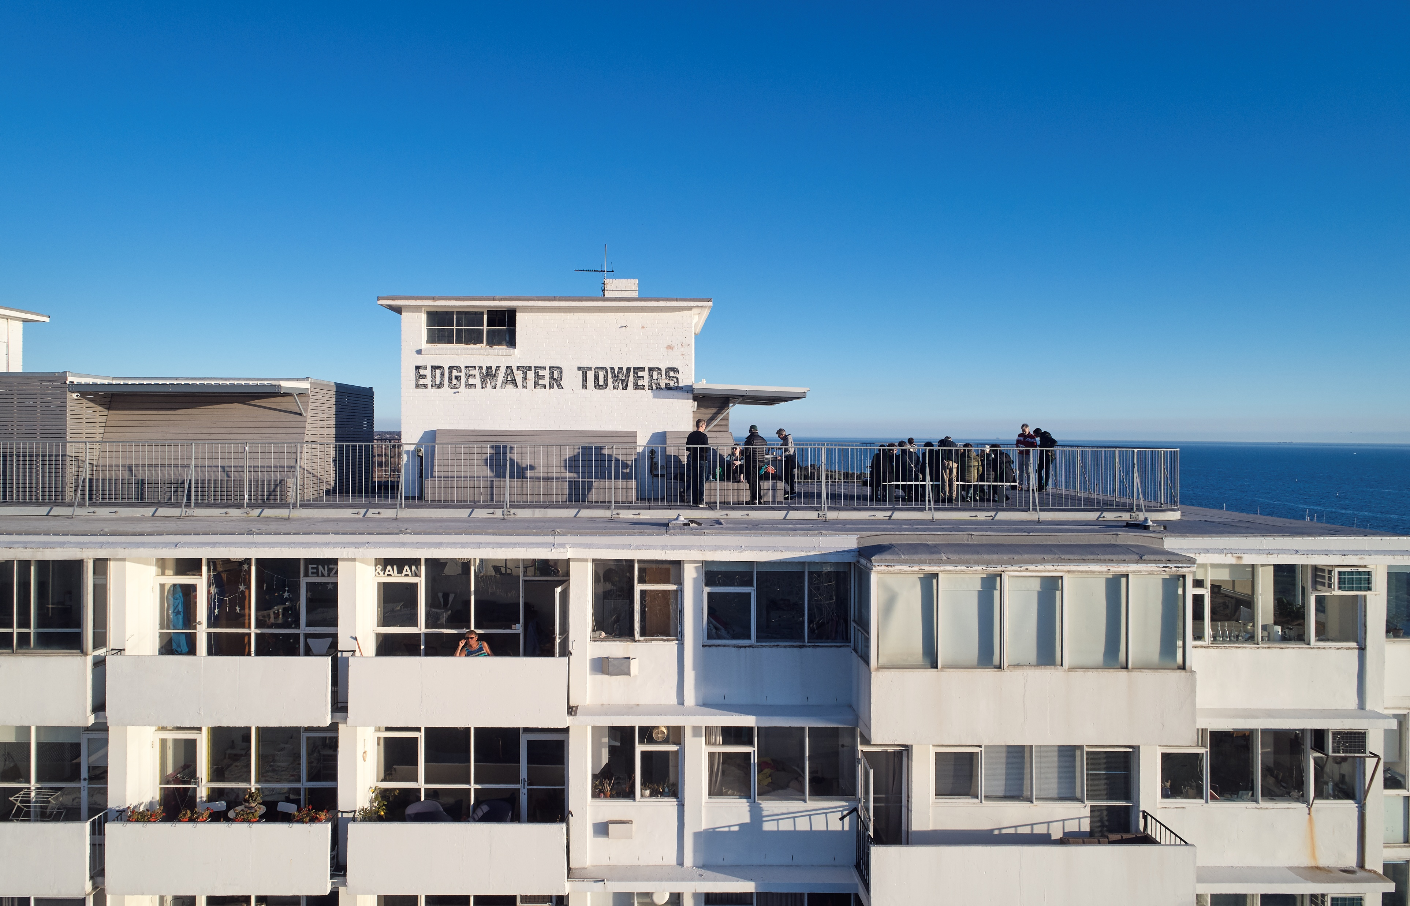
5. Minutes of Previous AGM
Image Credit: Peter Bennetts – with permission

Slide 6
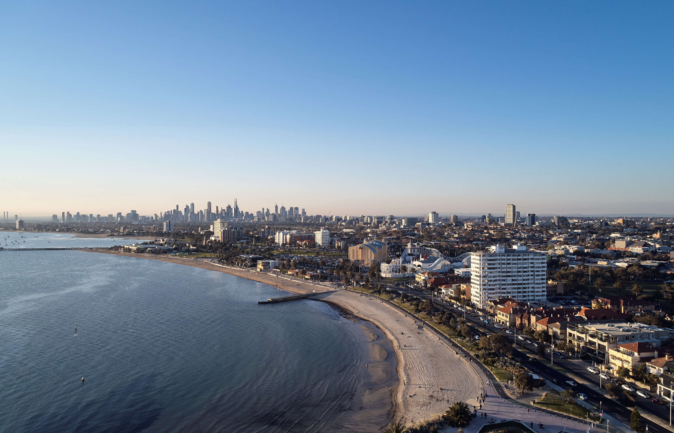
6. OC Chair’s Report
Image Credit: Peter Bennetts – with permission

Slide 7
Current Committee
Andrew Hackworth
John Van Der Laan
Mark Brickles
Morgan Adams
Russell Jessop
Sym Kohn
Christina Fitzgerald
James Gitonga

Slide 8
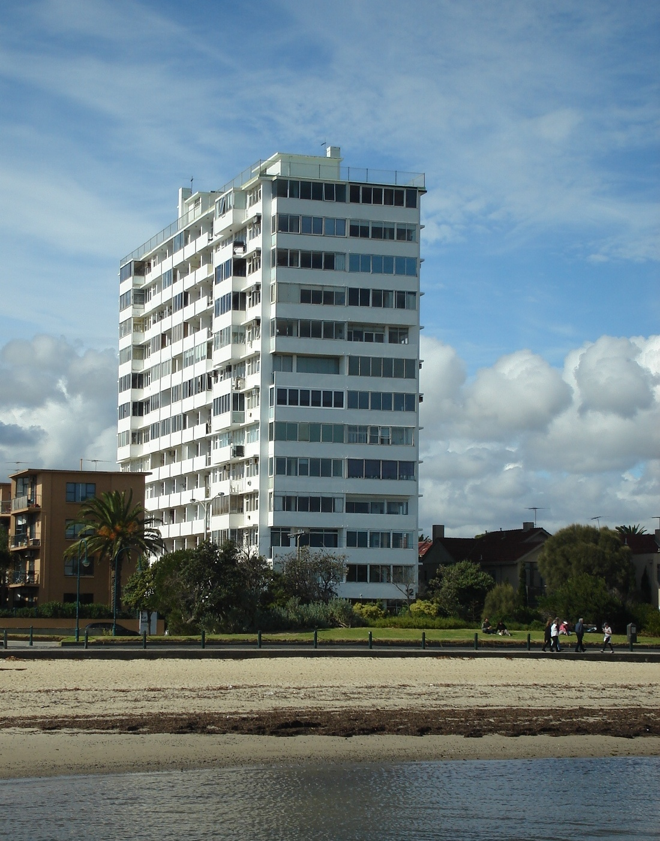
What We’ve Done This Year

Slide 9
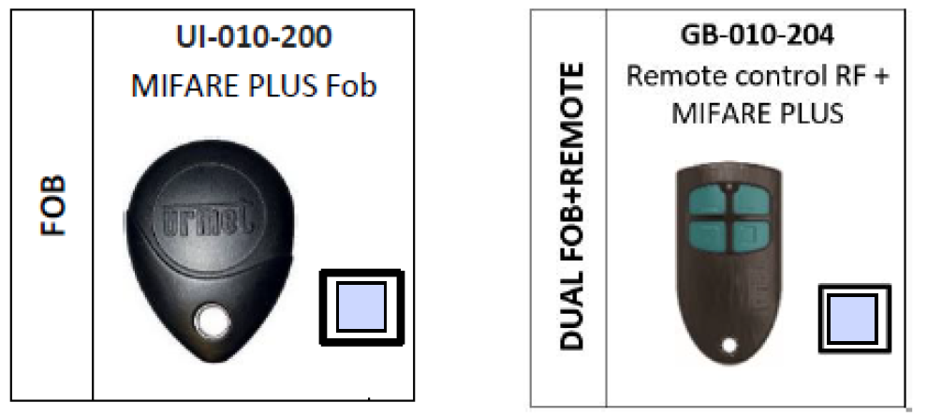
Access system control upgrade completed April 2025

Slide 10
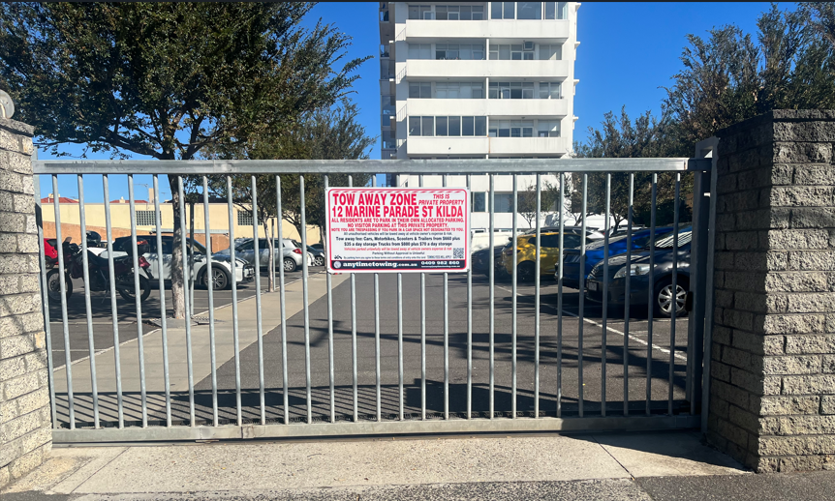
Car park vehicle Tow Away completed April 2025

Slide 11
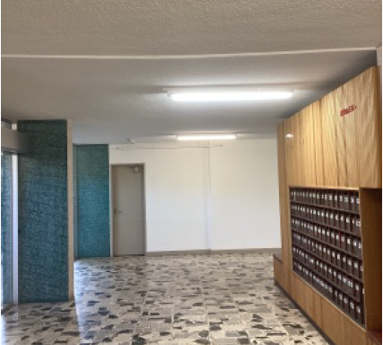
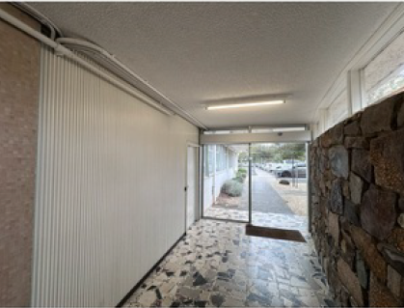
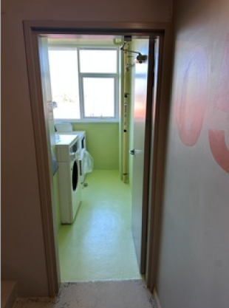
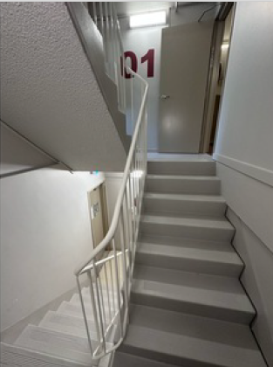
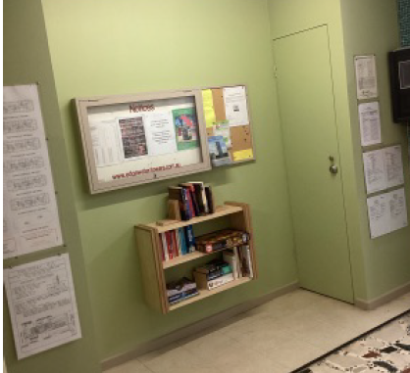
Lobby, Laundries & lower stairwell
refurbishment completed June 2025
Repainted Lobby
All six laundries
Both stairwells Grd-L3

Slide 12
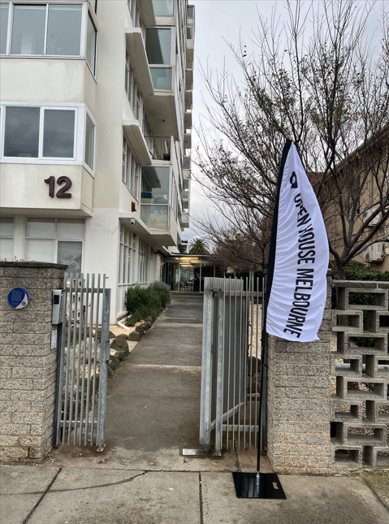
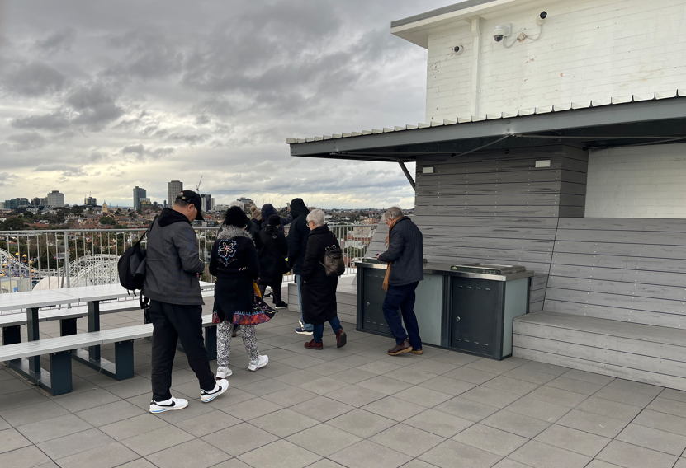
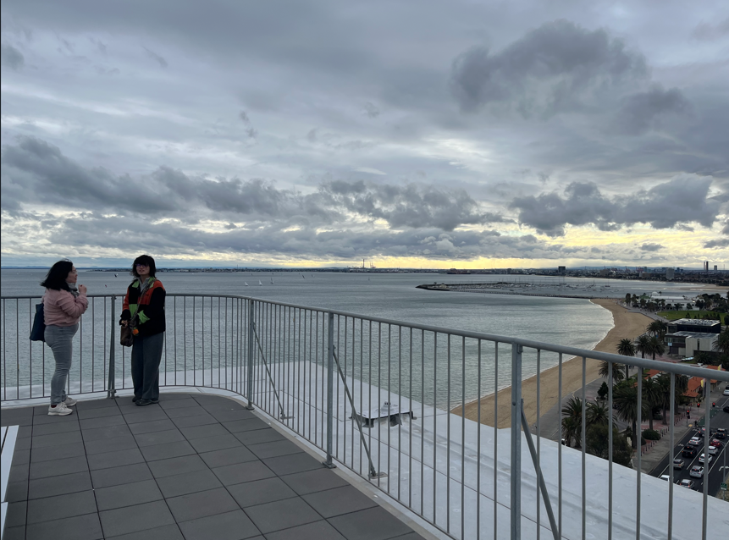
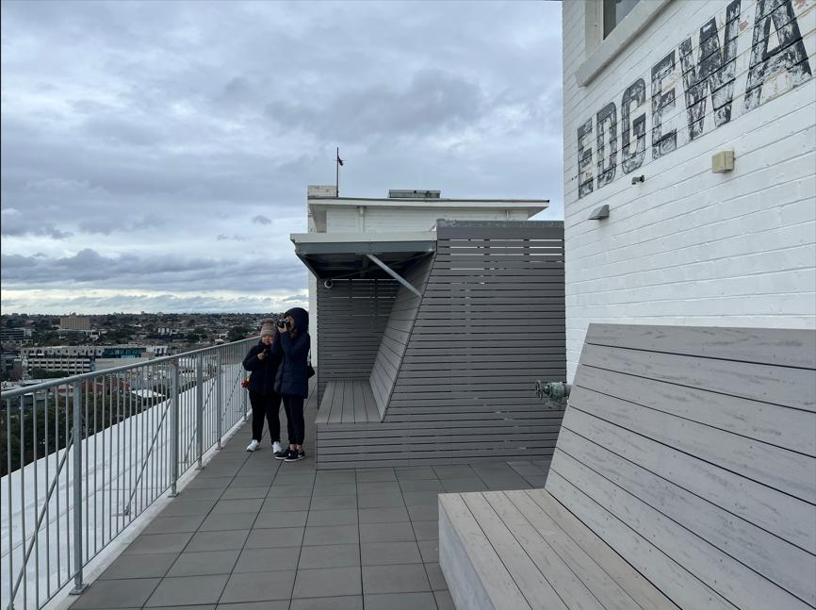
Our 9th Open House Melbourne 26th July 2025
A record 300+ visitors on the day

Slide 13
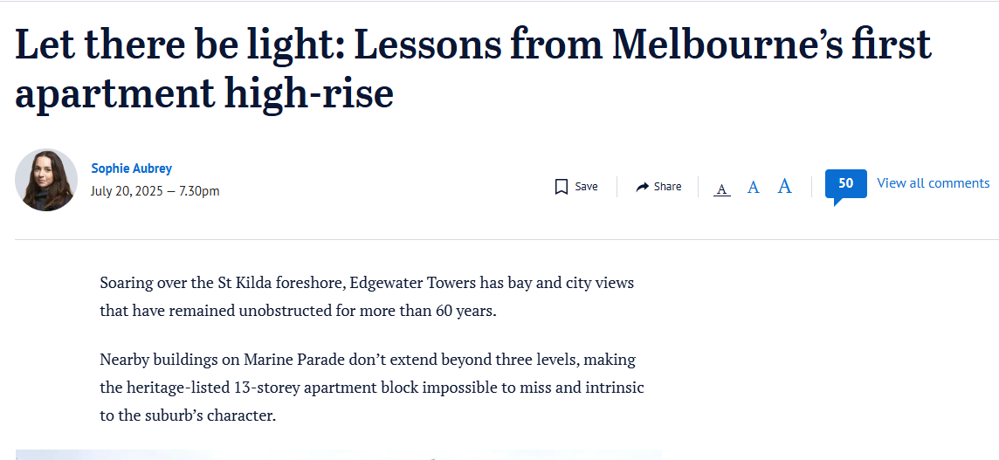
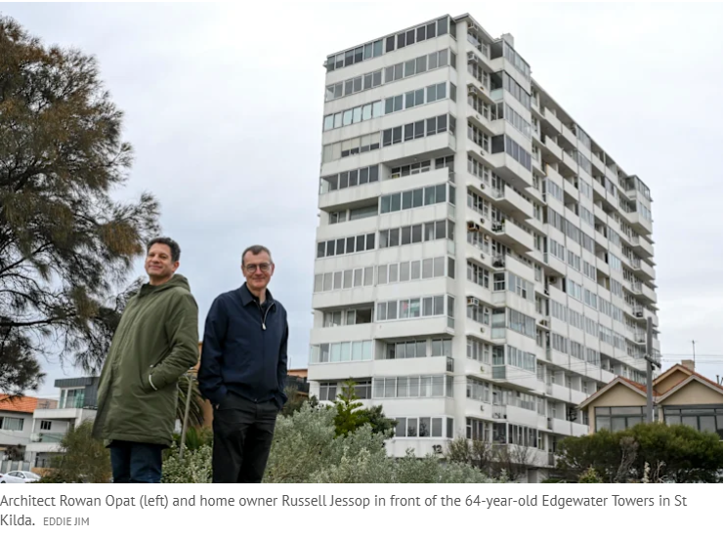
Age Newspaper Article Monday 21st July 2025

Slide 14
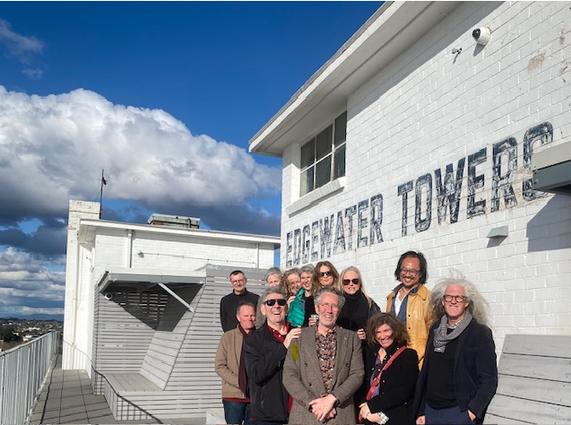
Past residents from Mid. 90s visitor tour 31st August 2025

Slide 15
Achievements Over the Last
15 Years

Slide 16
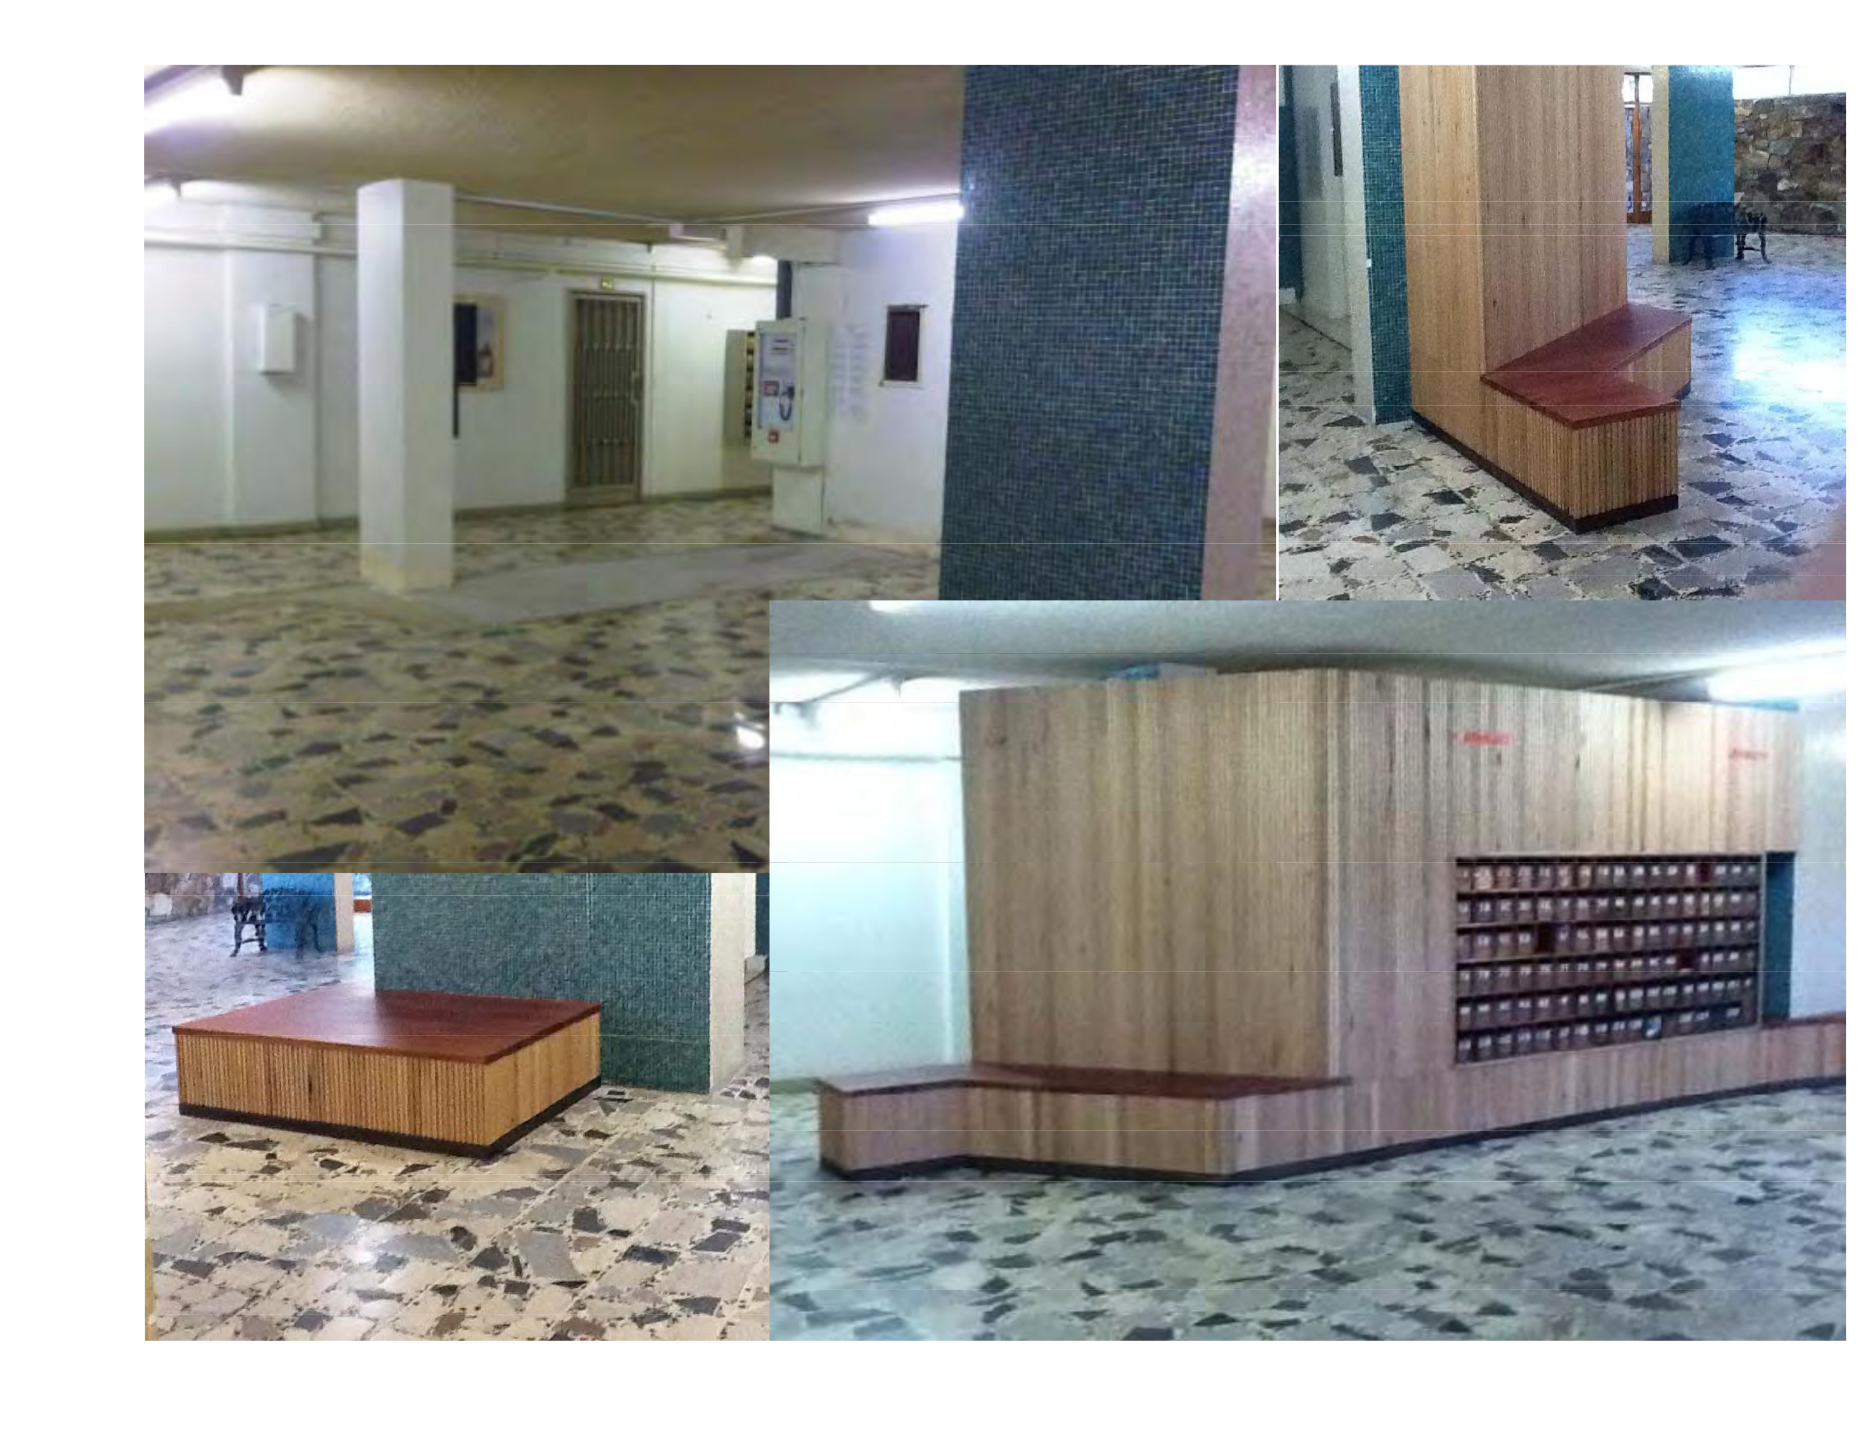
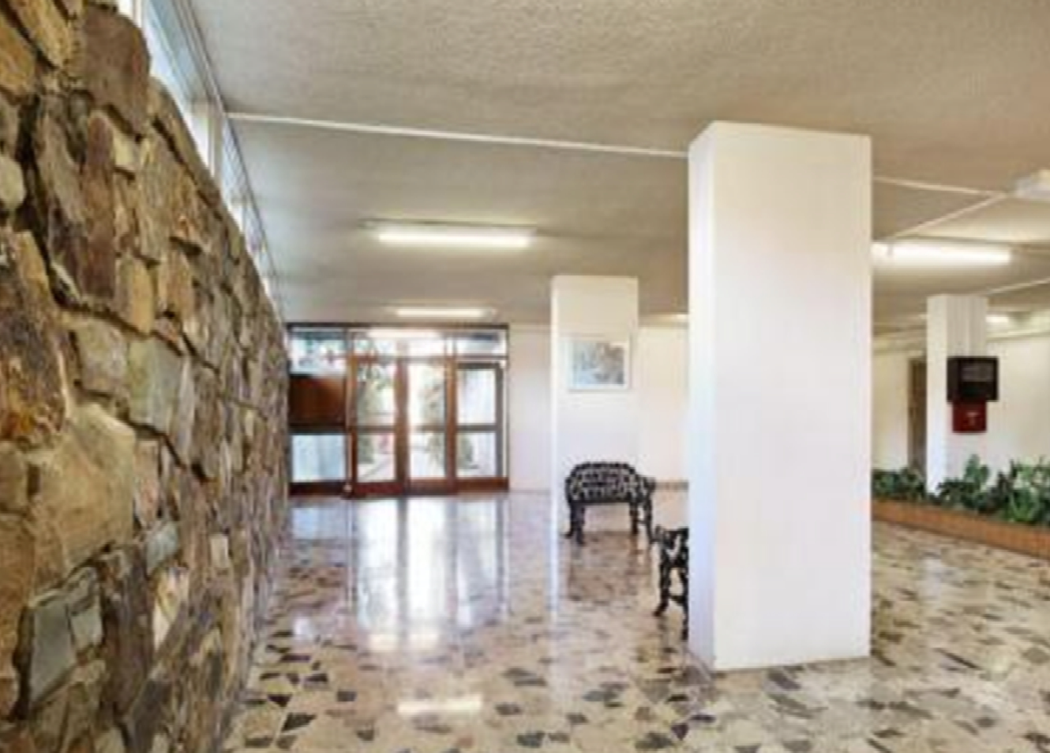
2010
Scraped white paint from columns
Removed old planter box
New installation making letter boxes a focus
Installed security gates in car park

Slide 17
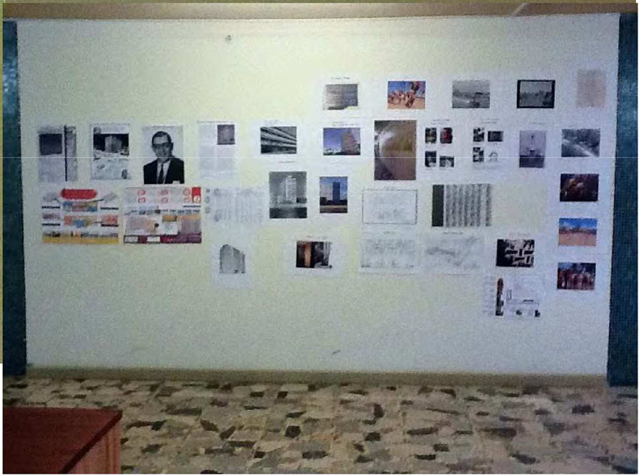
2012
Entered Edgewater into the Open House Melbourne program

Slide 18
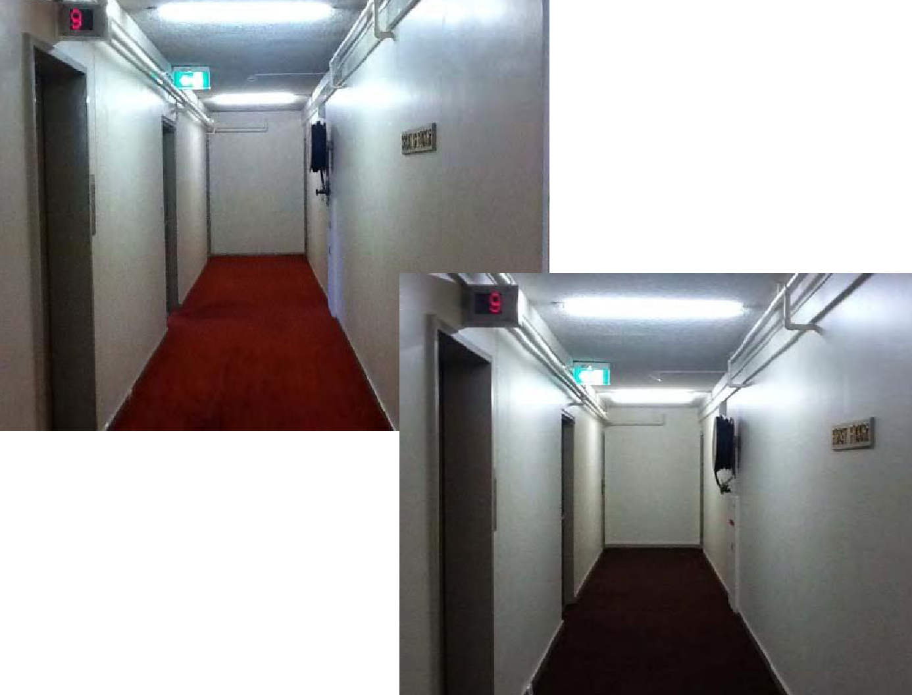
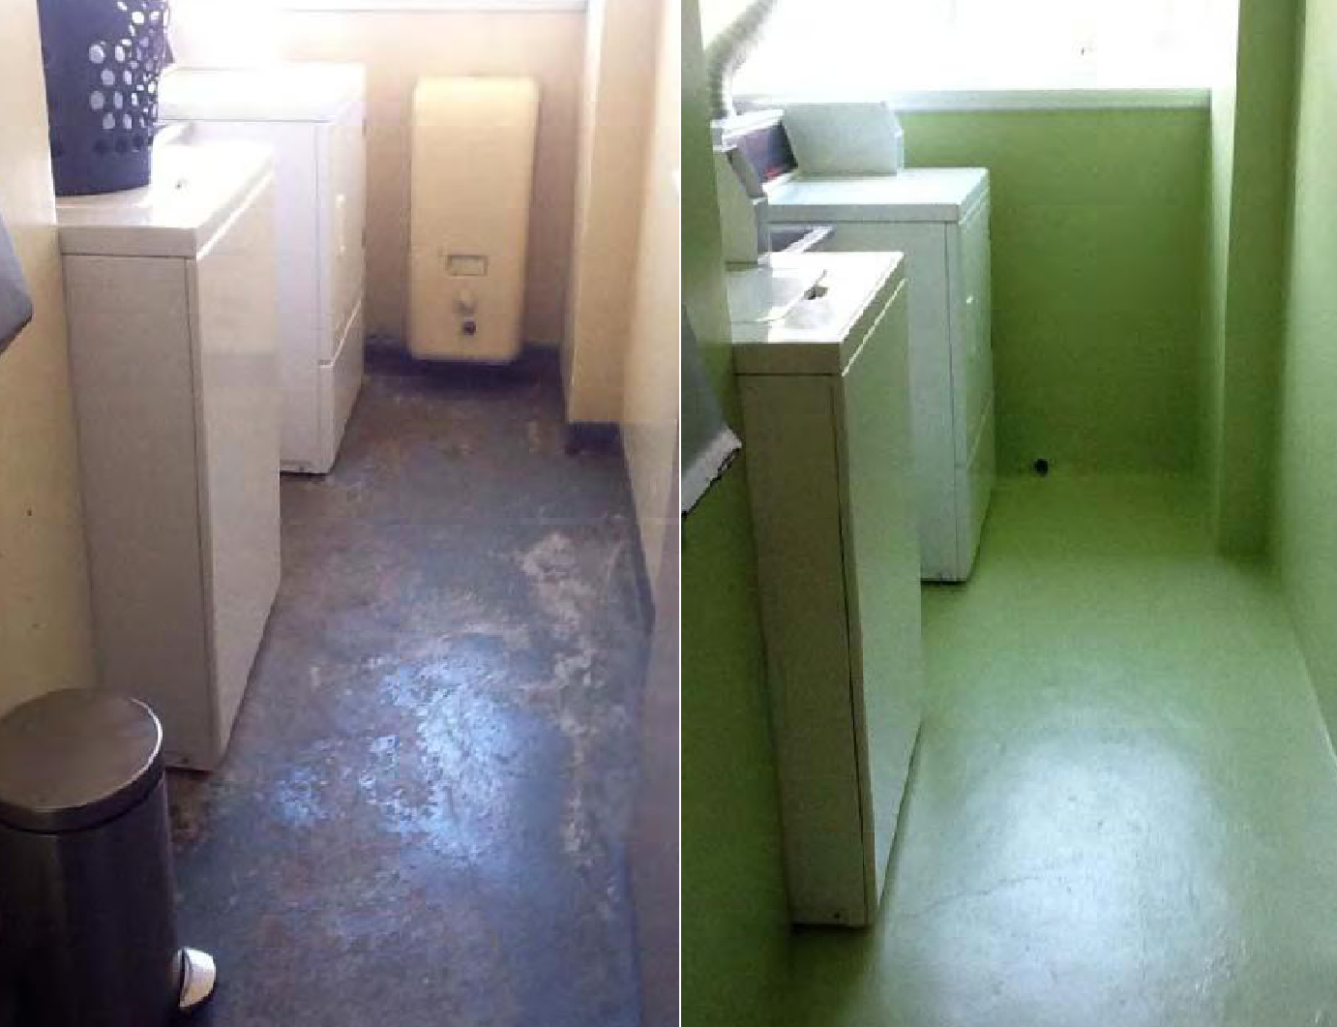
2012
Refurbished the corridors and the laundries and installed washing machines & dryers.

Slide 19
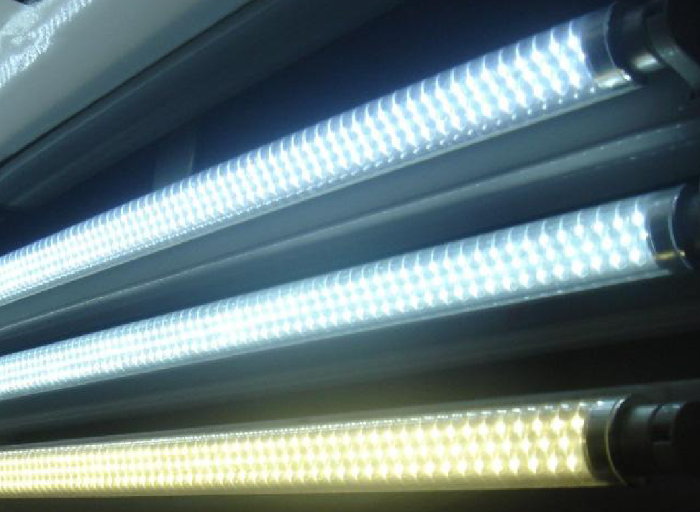
2013
Low energy lighting and stairwell lighting level compliance upgrade

Slide 20
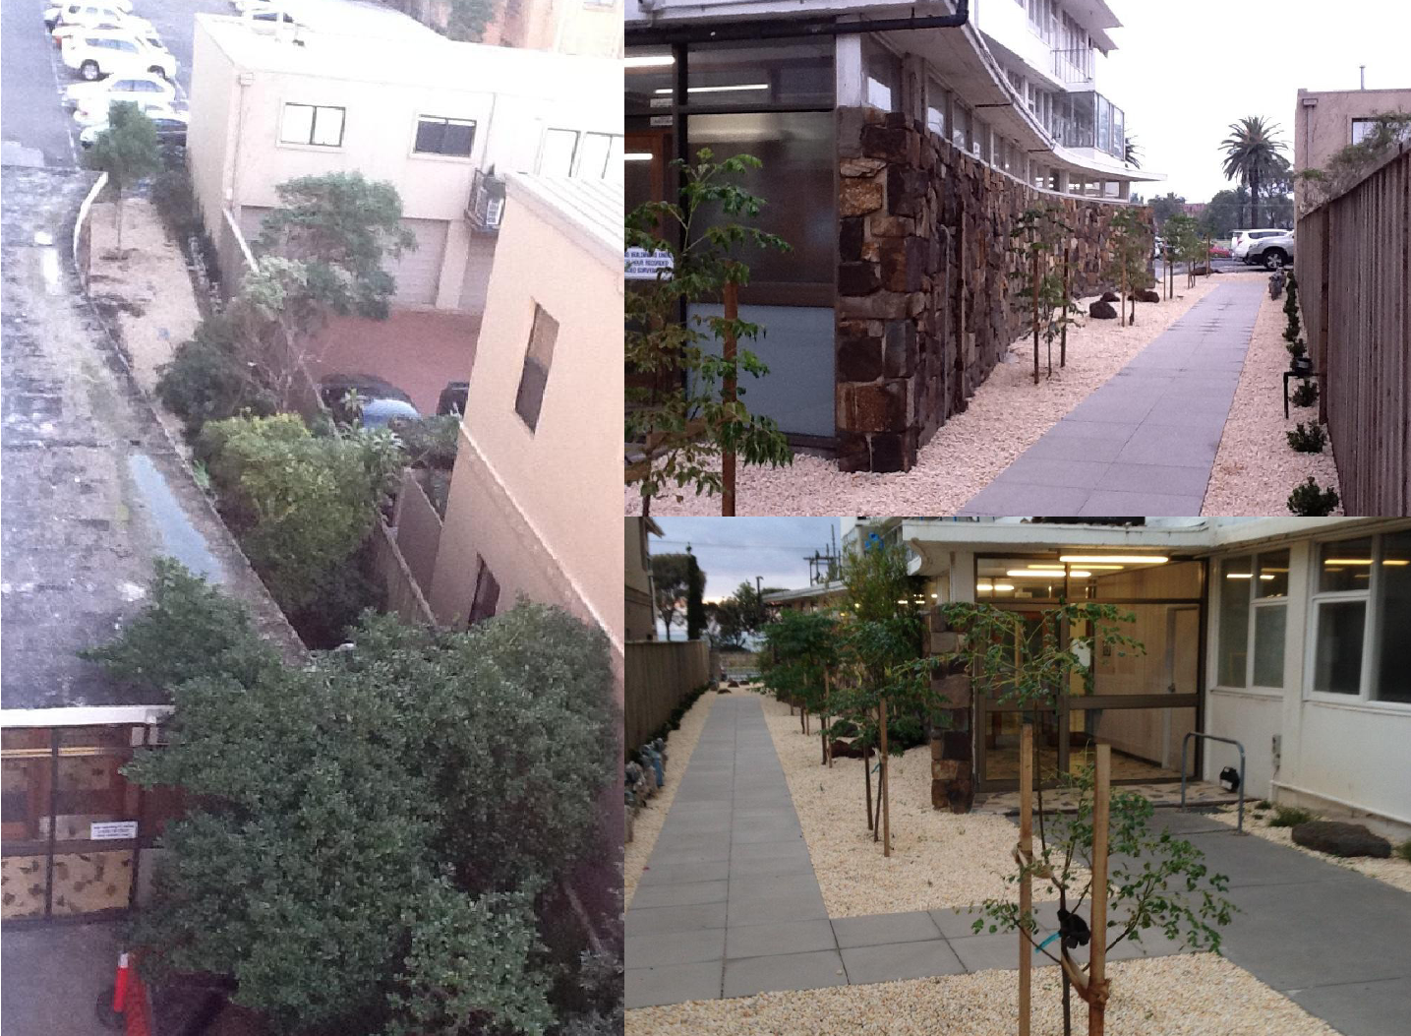
2013
Landscaped the grounds with native trees, plants, and herbs

Slide 21
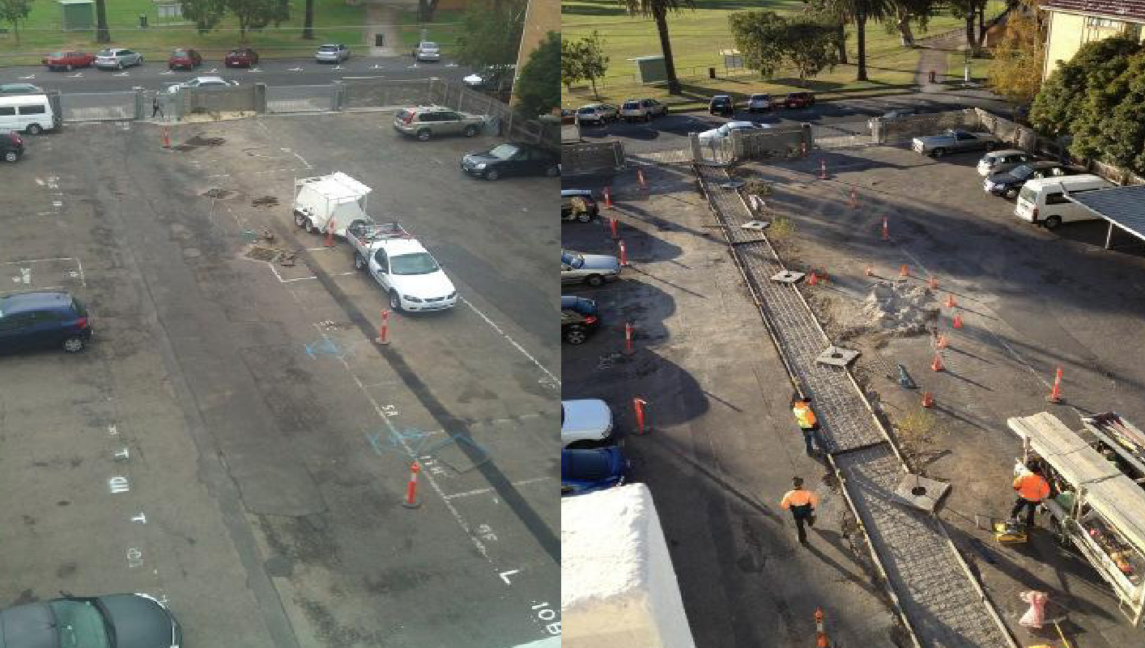
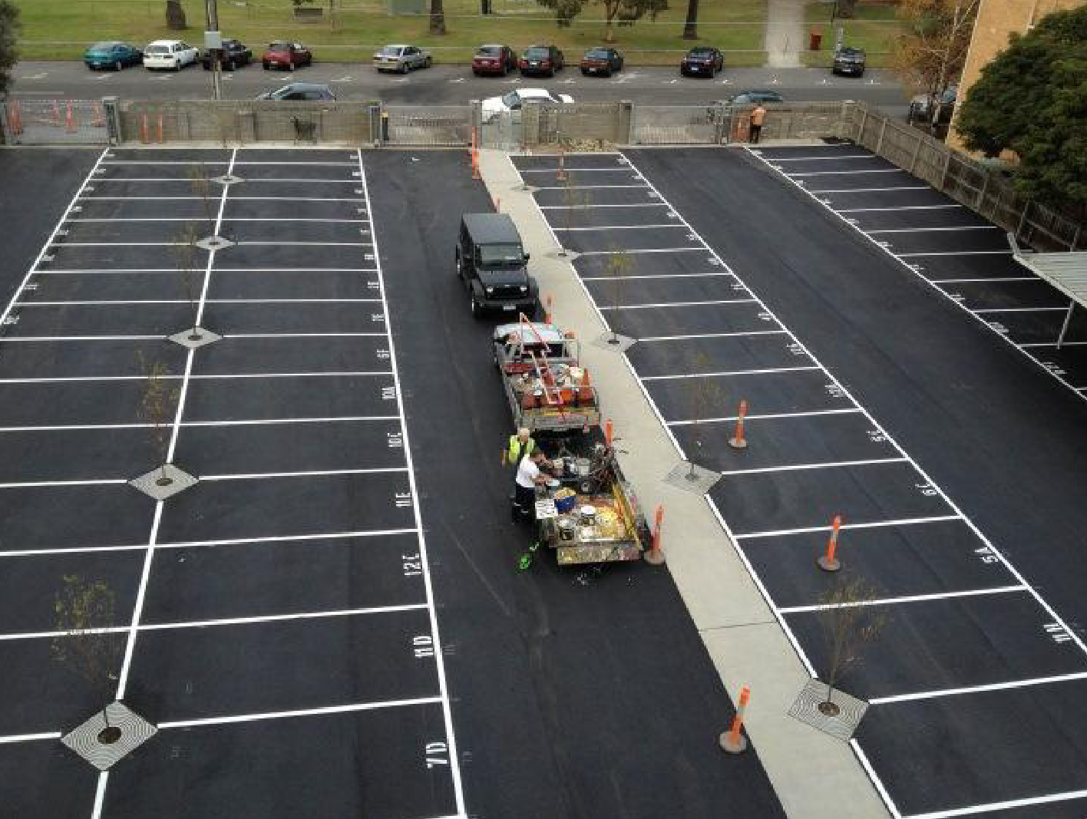
2013
Resurfaced the car park

Slide 22
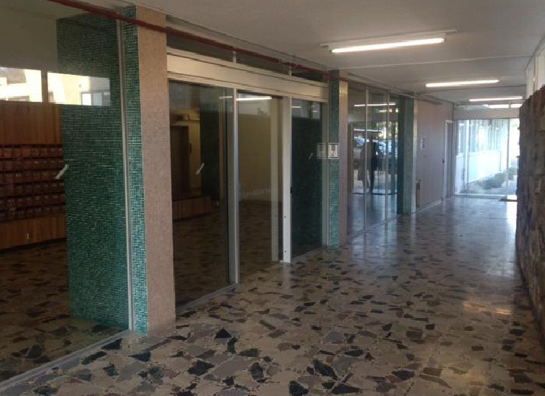
2014
Airlocks project

Slide 23
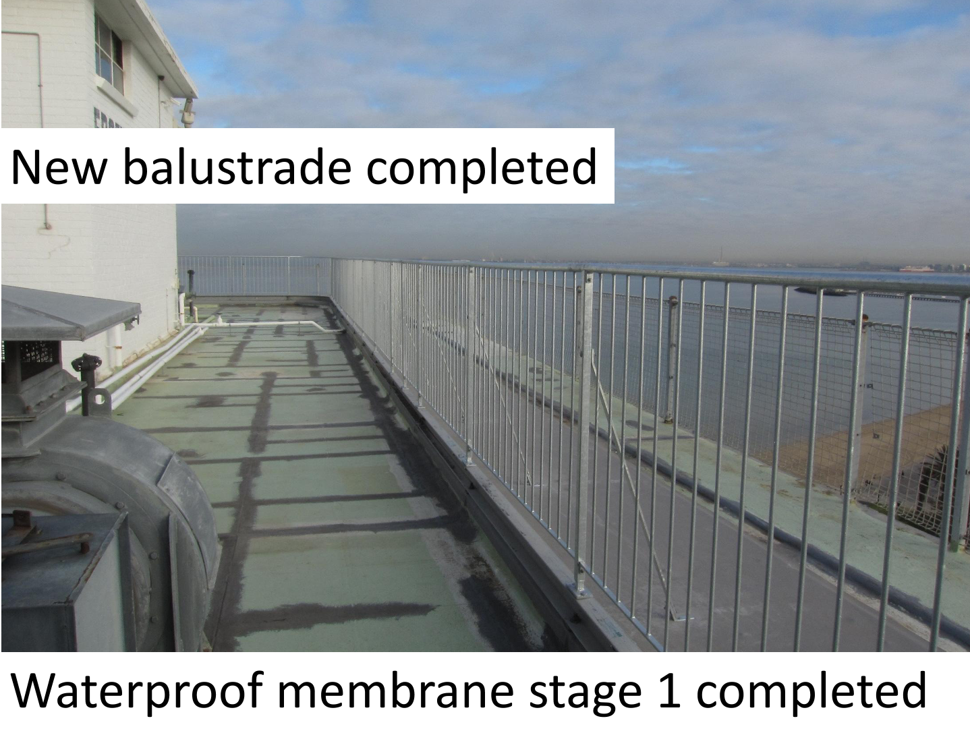
2015
Rooftop project started

Slide 24
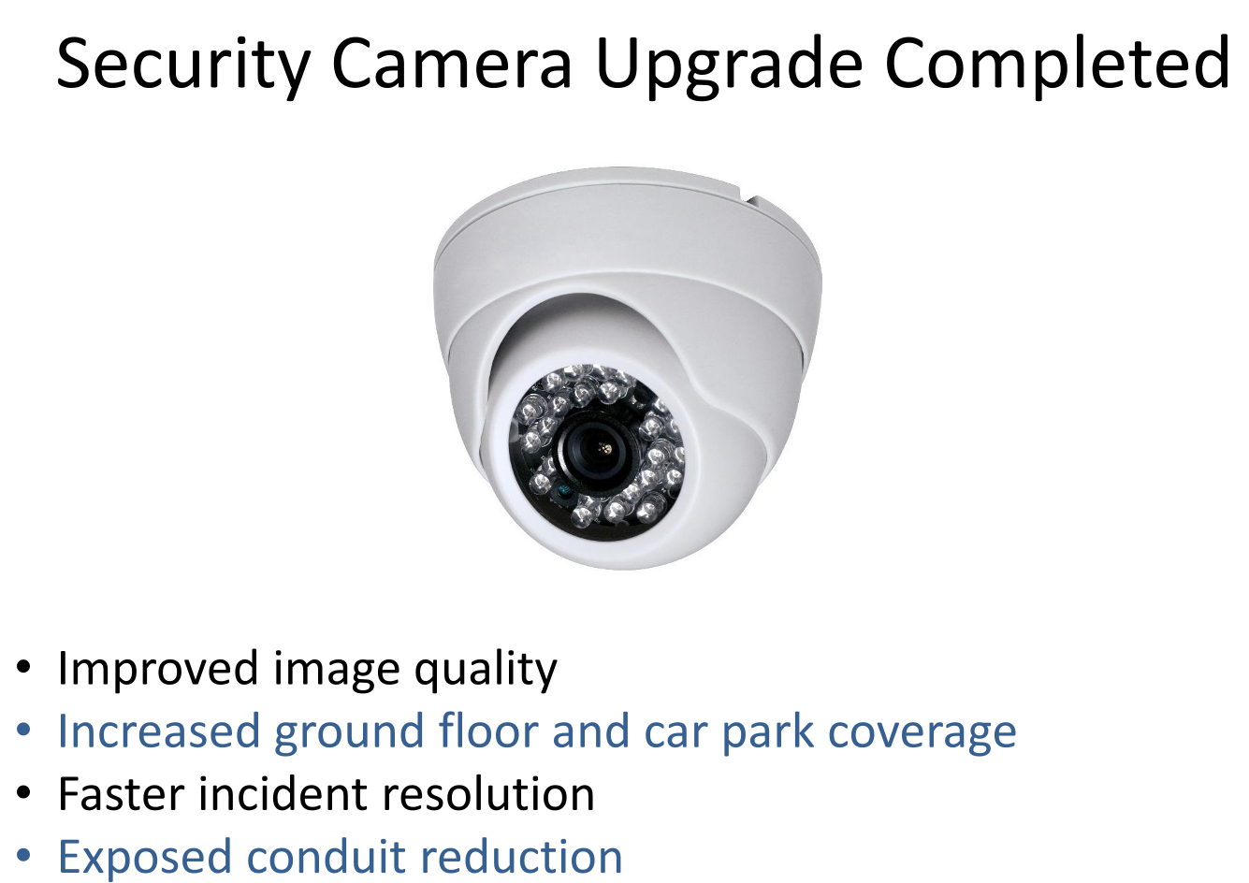
2017

Slide 25
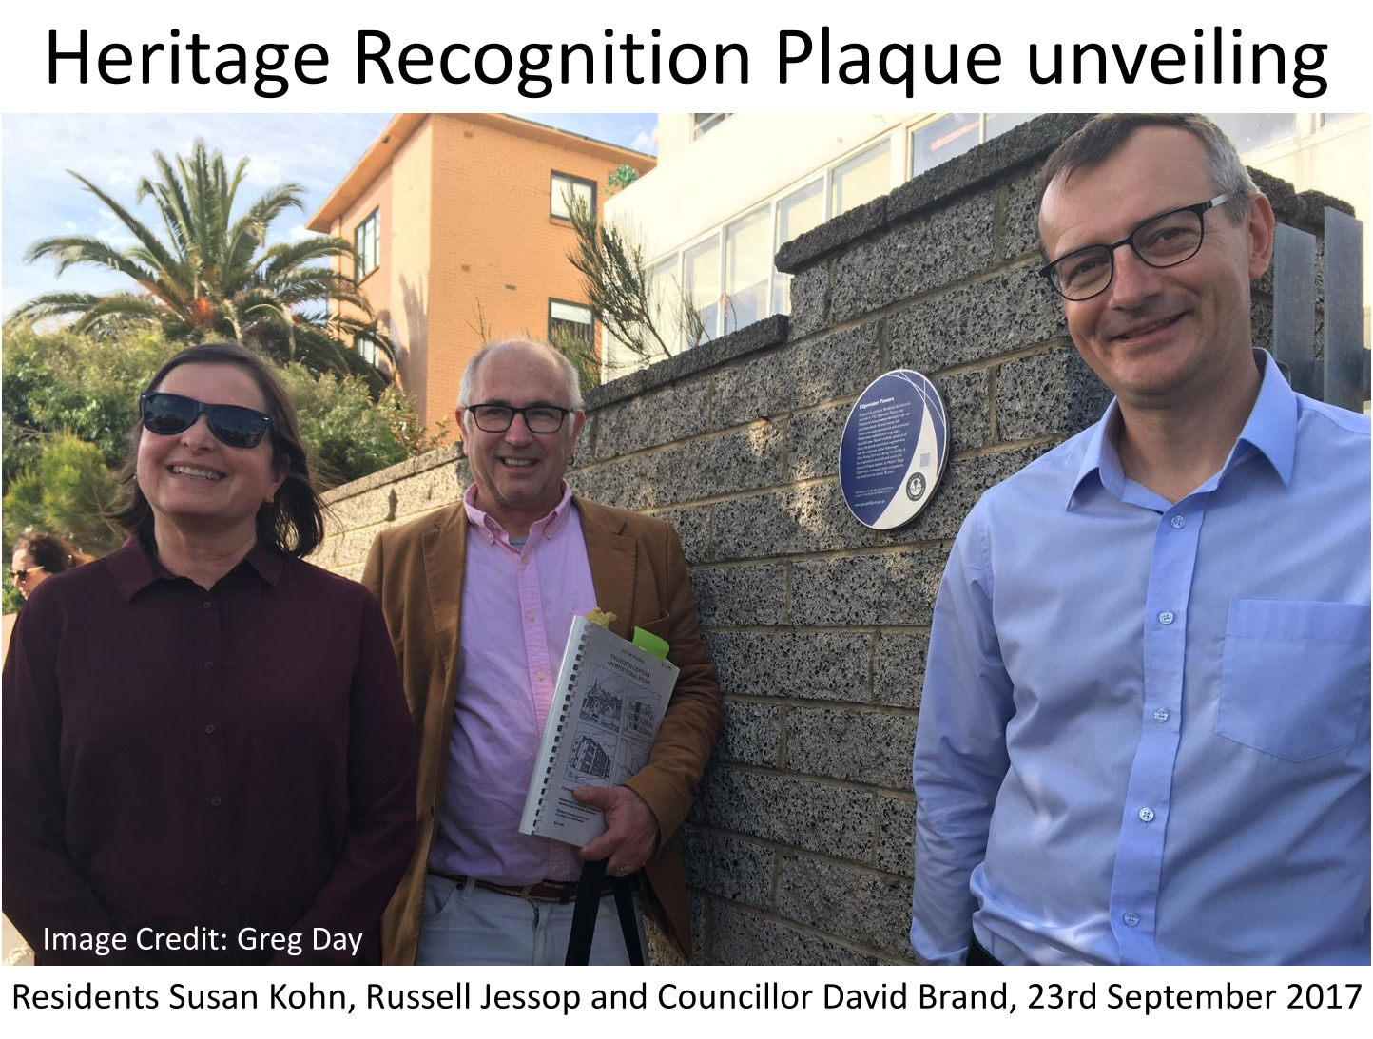
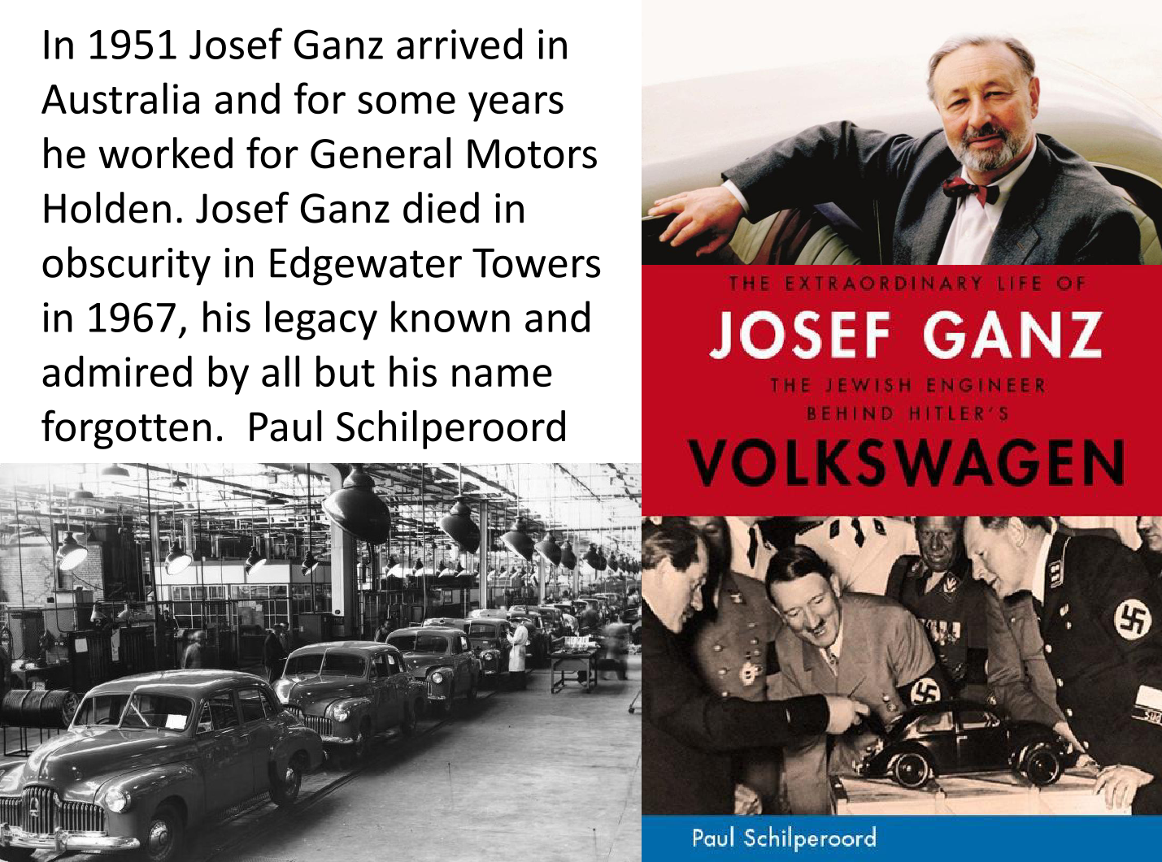
2017
Heritage recognition

Slide 26
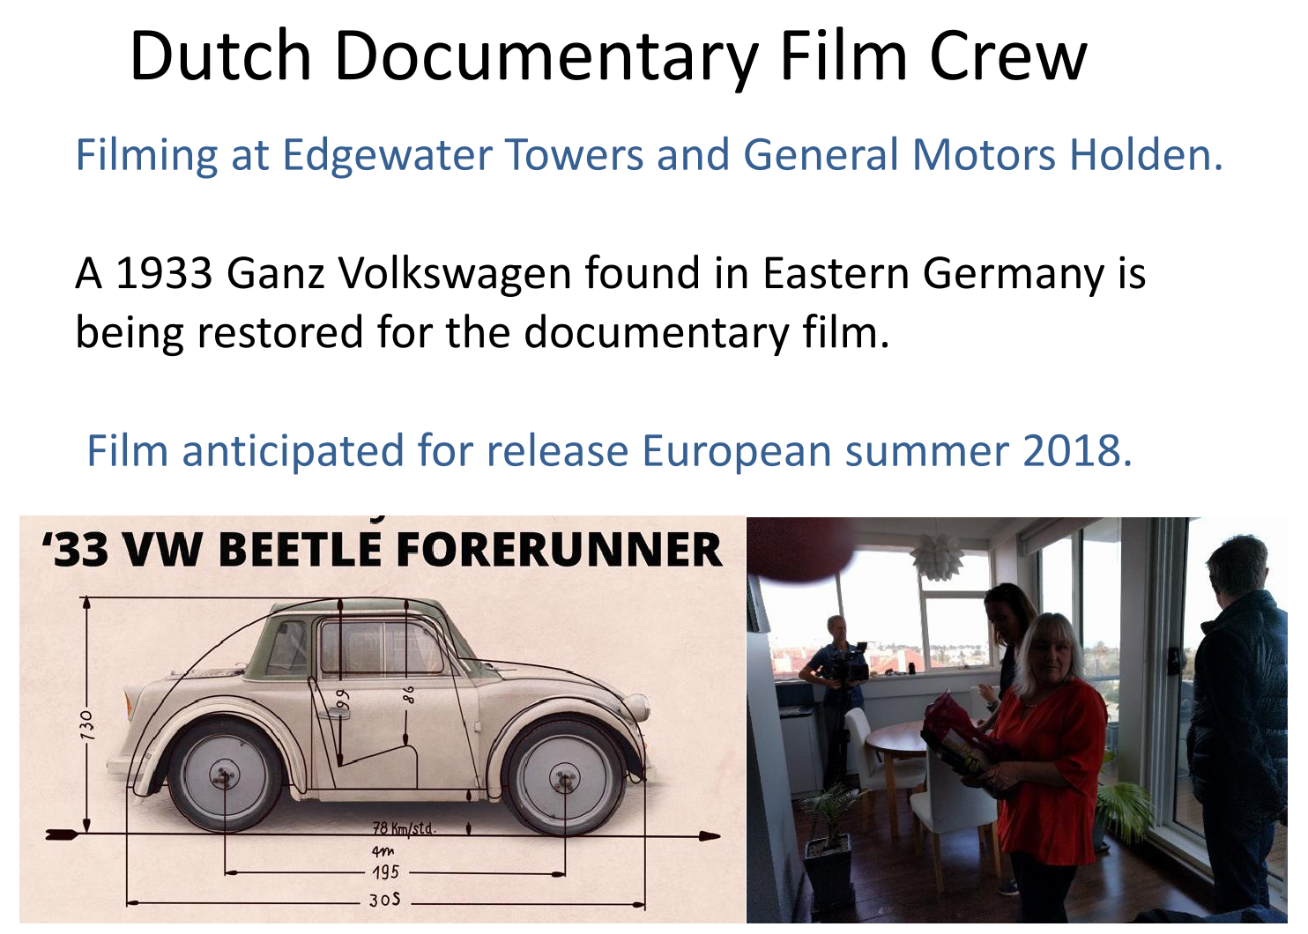
2017
Heritage recognition

Slide 27
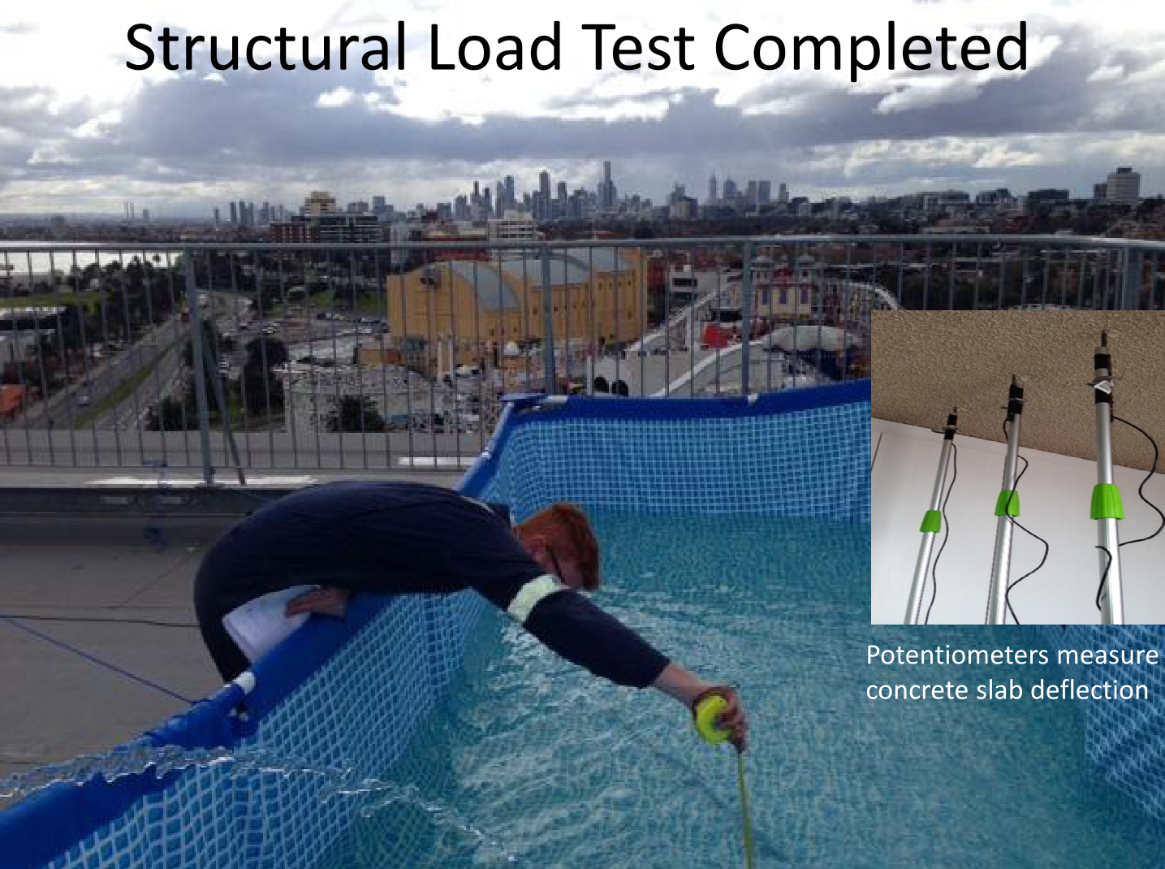
2017
Rooftop project continues. Testing the roof.

Slide 28
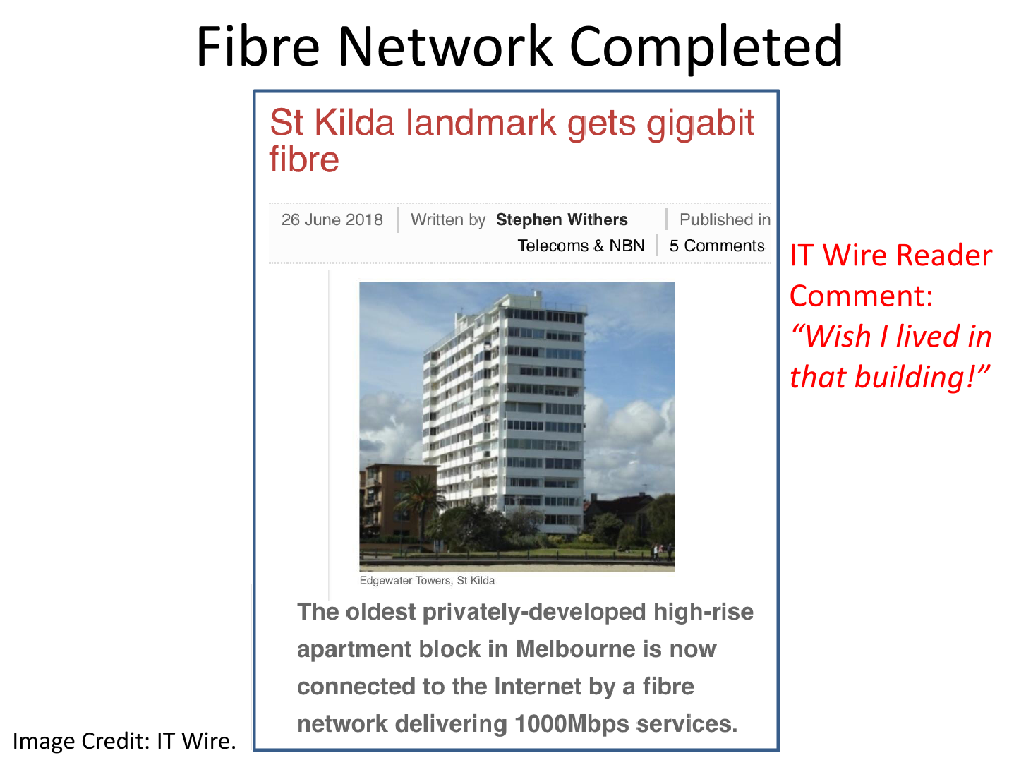
2018
Private network using Pineapple as our ISP.
150 / 150 $69 pm
250 / 250 $79 pm
500 / 500 $89 pm
1000 / 1000 $99 pm

Slide 29
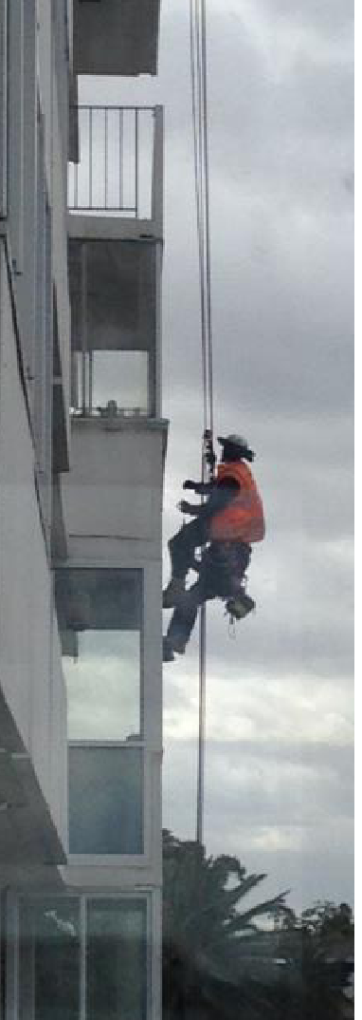
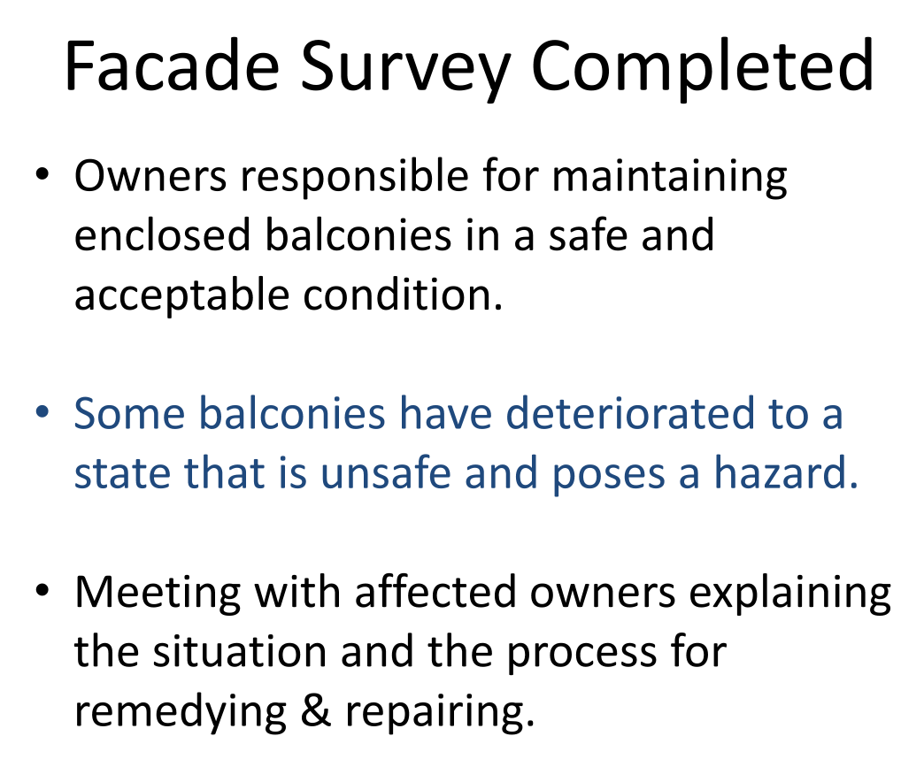
2018

Slide 30
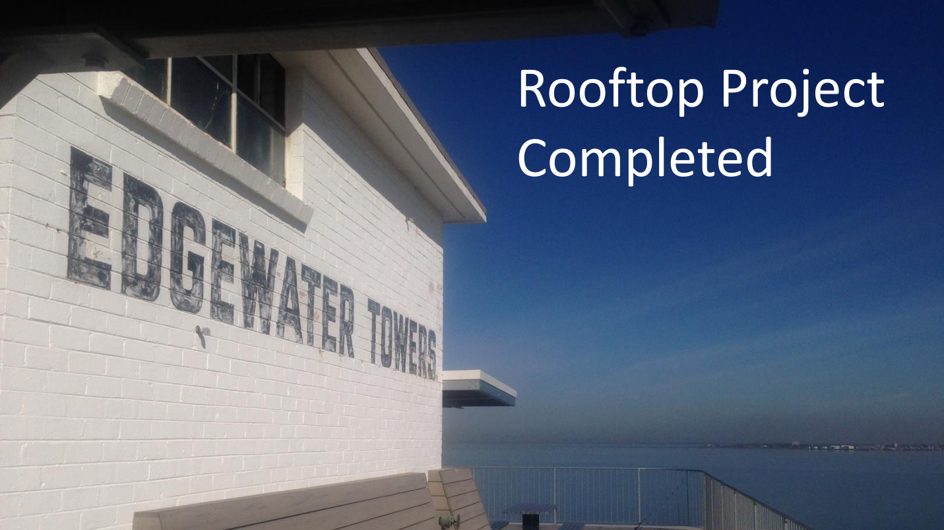
2018

Slide 31
2019
Conversion to strata

Slide 32
2020 - 21
COVID LOCKDOWNS

Slide 33
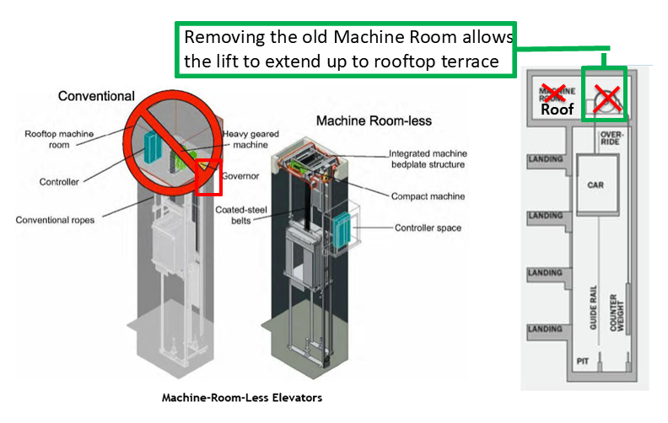
2022
Replacement of lifts begins.
One lift will go up to the rooftop

Slide 34
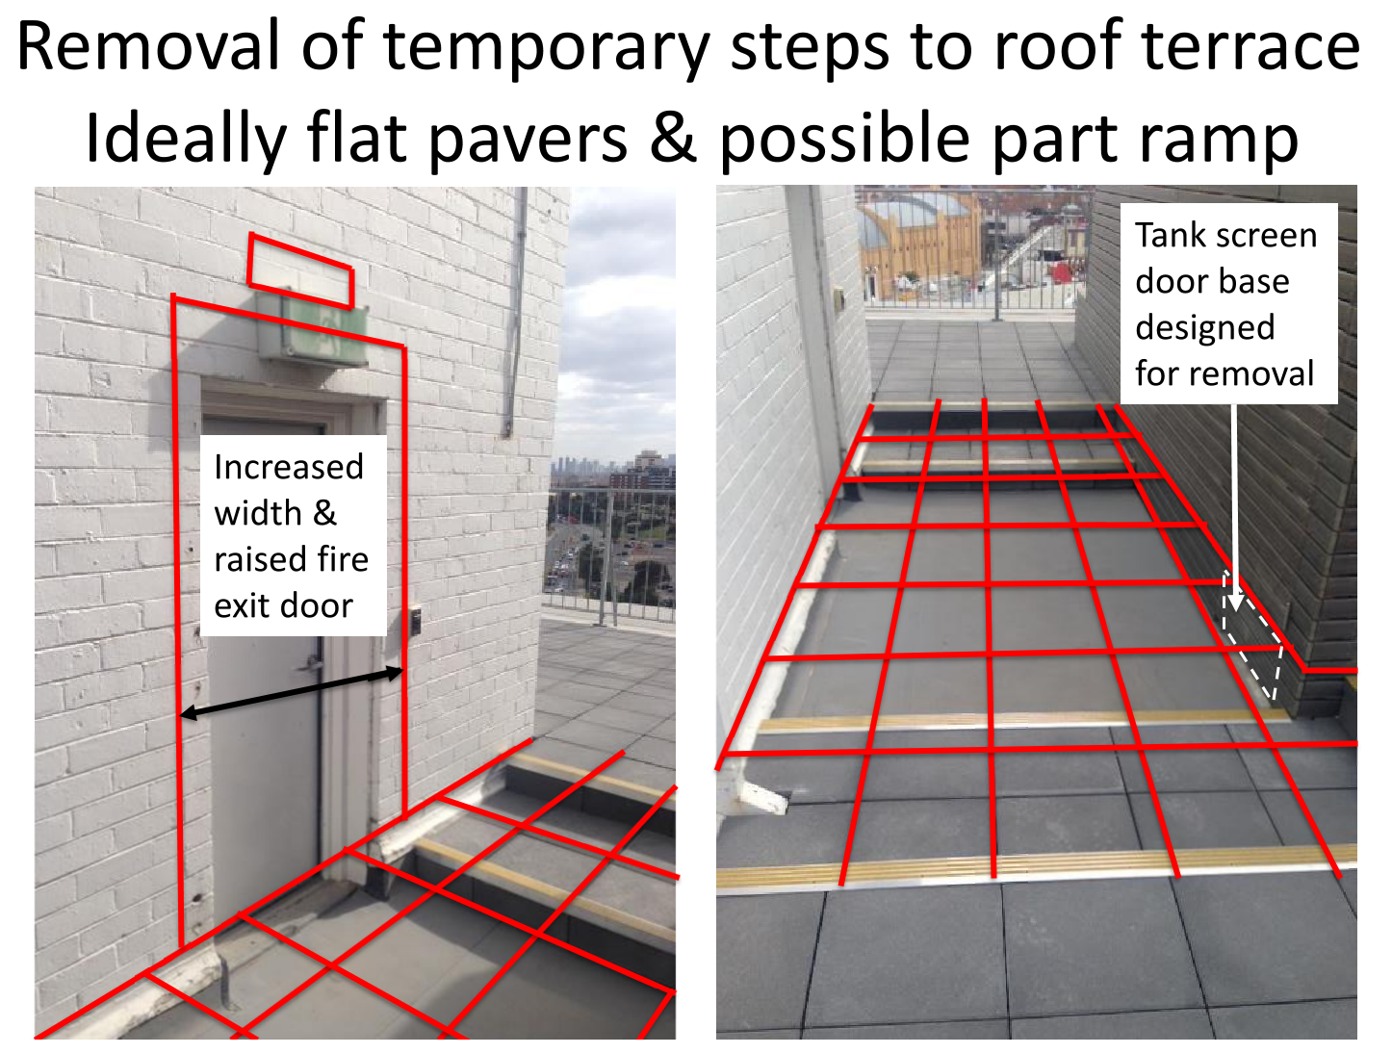
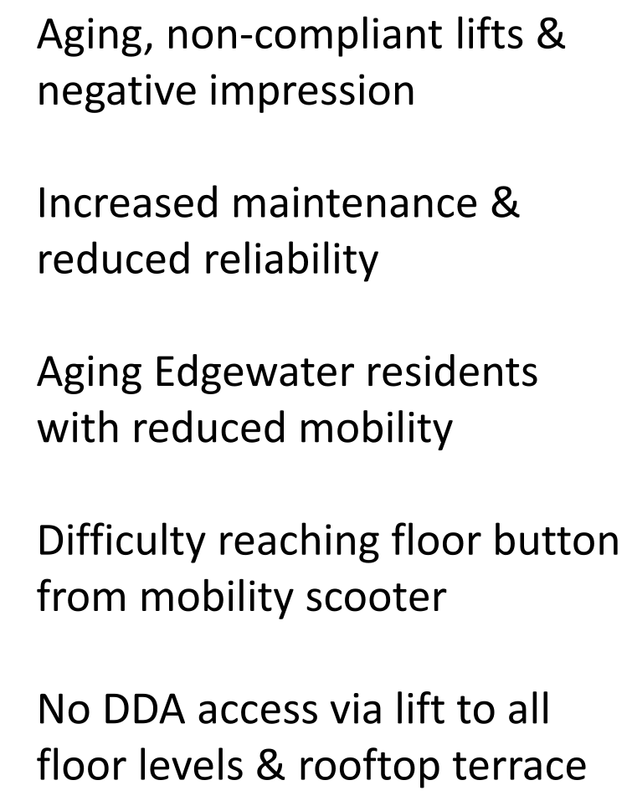
2022

Slide 35
2022
Façade Remediation
Colin Trewern & Roger Hackworth start the preliminary investigation.

Slide 36
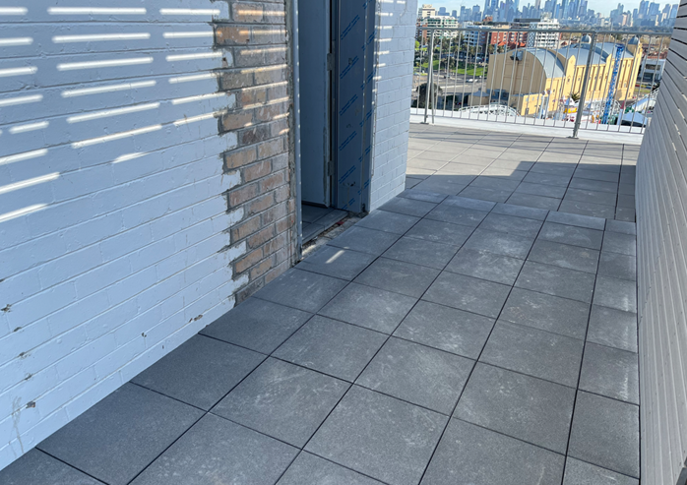
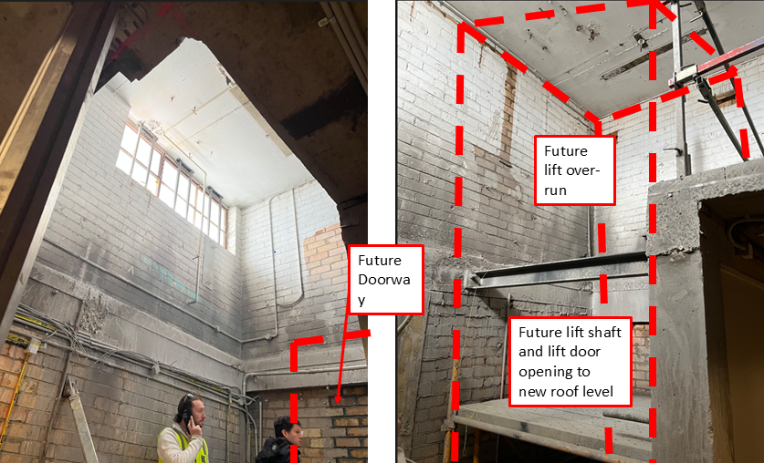
2023
Construction works required to enable lift installation

Slide 37
2024
Lift Project Completion
West lift completed December 2023
East lift completed July 2024
Increased speed from 0.8 to 1.75m/s
Increased capacity from 1000kg 13 person to 1150kg 15 person
Disability Discrimination Act 1992 (DDA) compliant for all abilities with wider lift opening doors increased from 820mm to 900mm

Slide 38
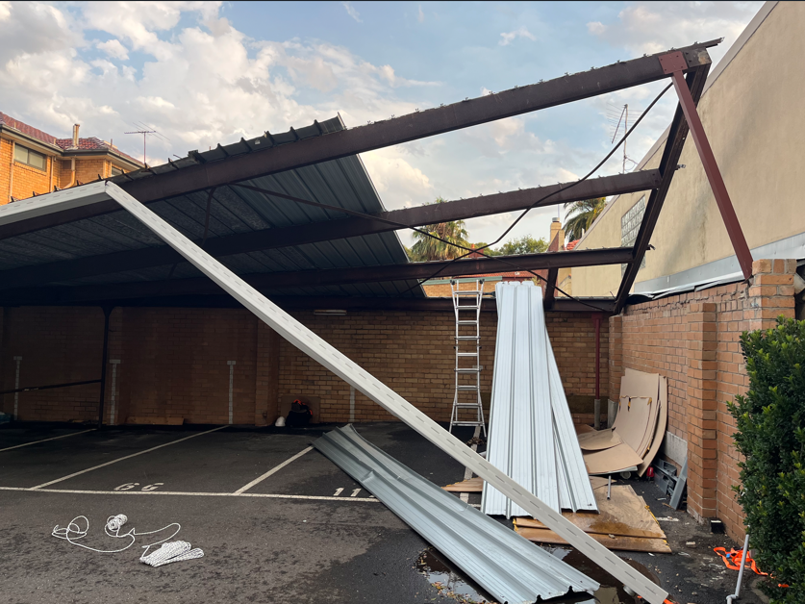
2024

Slide 39
Façade Refurbishment Project Update
Image Credit: Peter Bennetts – with permission

Slide 40
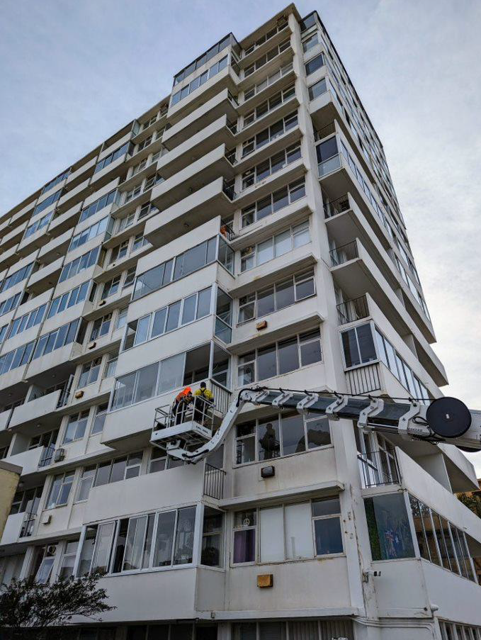
Façade Refurbishment Project Update
30 September 2025
Zoom owners meeting to update the status of the project with over 40 owners attending

Slide 41
Façade Refurbishment Project Update
Why we need the repair work.
Liability Risk
Safety of occupants & visitors
Integrity pf the building
Maintain value of the building
Pride

Slide 42
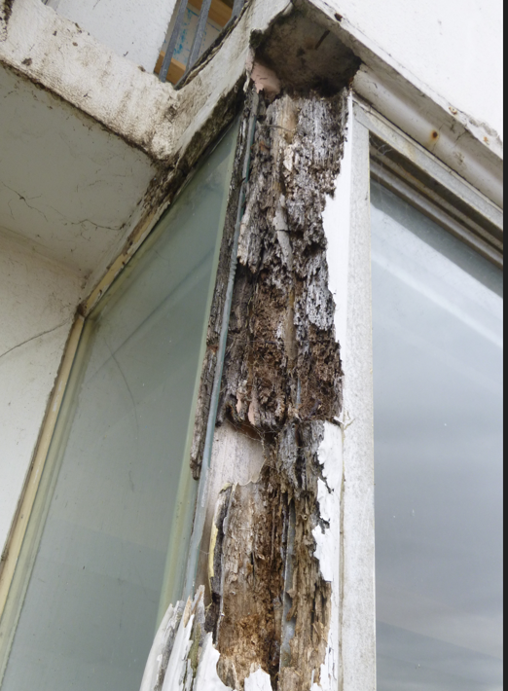
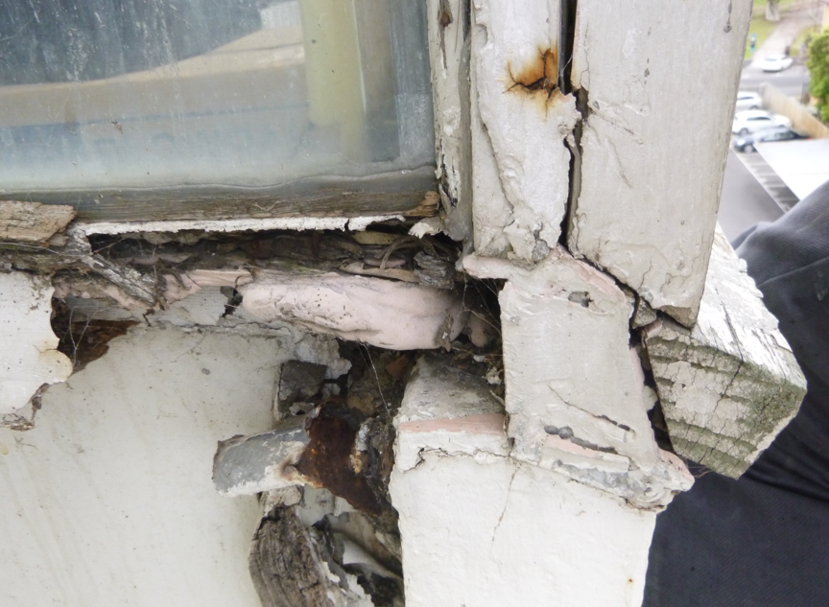
Façade Refurbishment Project Update
Do we really NEED repairs?

Slide 43
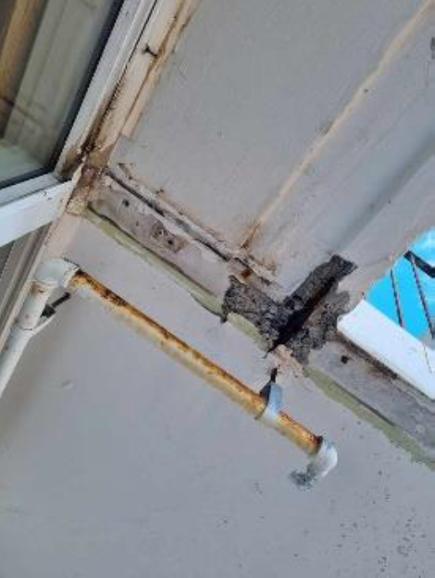
Façade Refurbishment Project Update
Some of the problems

Slide 44

Façade Refurbishment Project Update
More of the problems

Slide 45




Façade Refurbishment Project Update
A few extra – for good measure

Slide 46
Façade Refurbishment Project Update
The companies involved:
INFRACORR -specialist façade repairs consulting engineers
BSGM Building Surveyors- regulatory & Council applications
RB Lawyers – legal overview

Slide 47
Façade Refurbishment Project Update
Expected Timing | Stage
30 Sep 25 | Inspections, planning & consultations
30 Nov 25 | 60% design development completed
15 Feb 25 | 90% design development & tender documentation complete
28 Feb 26 | Issue Invitation to Tender to contractors
30 Apr 26 | Receipt of tenders
15 May 26 | Evaluation of tenders
June – July 26 | Presentation to Owners & start of voting process
15 Jul 26 | Final decision by owners
31 Jul 26 | Awarding of contracts
12-15 months later | Project completion (WE HOPE !!)

Slide 48
Scope of Work
Existing timber windows to be replaced with aluminium frame and glazing:
L1-12: 2 Bed A, B, G & H flats Kitchen & Main Bedroom windows (Inc. side balcony door/frame).
L1-12: 1 Bed D & E flats Kitchen windows.
L1-12: Laundry and Bike Rooms windows.
Ground: GA/B all windows.
Ground: GD & GF all windows.
Ground: GG & GH Kitchen, Second bedroom and Main bedroom.
Ground: Cleaners.
Included in base scope of work: Single glazing, North facing grey tint, South facing clear. Top hung
window openings.
Additional cost option: Double glazing of each size of window.

Slide 49


Slide 50
Existing timber windows to remain (repair/repaint):
Ground: Lobby air-lock high level window and WC high level window.

Slide 51
Enclosed previously open balconies:
Enclosure of open balconies started in the 1960s. Each balcony
enclosure had a unique design until an Edgewater “standard”
designs (1 Bed 4 panel design and 2 Bed 6 panel design) were
adopted in 1995.
All enclosures not complying with the “standard” infill design to be
replaced due to non-conformity and age, before 1995 (i.e. 30years+).
All enclosures that include any hybrid of materials including using
timber in their construction to be replaced.
All enclosed balcony ends that are either not concrete or not
translucent white glass to be replaced with translucent white glass.
Example not complying 2bed:
5 panels not 6 panels
Example not complying 1bed:
6 panels not 4 panels

Slide 52
Concrete repair and repaint:
All concrete will be repaired and repainted
including concrete repairs that extend into flats and in open balconies (limited to concrete and reinforcement, not internal plaster and paint).

Slide 53
Open balcony:
All to be removed and replaced with hot-dipped galvanized steel painted black similar design to existing.
Open balcony concrete will be painted.
Example: 2 bed balustrade
Example: 1 bed balustrade

Slide 54
Air Conditioners:
Window installed AC units are the responsibility of the owner to arrange removal and reinstatement.
Water Heater Flues:
Redundant rusty flues no longer in use due to moving onto electrification to be removed and patched.
Active flues on gas fired water heaters to remain.
Example air conditioner
Kitchen Ventilation Fan/Exhaust:
Removal and reinstatement of existing glazing mounted fan/exhaust is included.
Example water heater flue

Slide 55
NOT INCLUDED IN THE PROPOSED SCOPE OF WORKS:
L1-12 2 Bed A, B. G & H open balcony existing timber glazing and doors.
L1-12 1 Bed C, D, E & F open balcony existing timber glazing and doors.
Enclosure designs that apparently meet the “standard” design but still may need to be replaced at a future time or are in poor condition. Some of these are close to 30 years old. Owners can request their infill to be included in the works should they wish to take advantage of access and available trades familiar with the installation.
Interior fit out removal to facilitate the works and reinstatement – e.g blinds and curtains, tiling etc.
Water-proofing of floor of open balcony.
Rooftop water-proofing membrane repairs.

Slide 56
DISCLAIMER
We are presenting costs that are VERY approximate but are based on information provided by Infracorr and confirmed as “in the ball-park” by engineers on the committee.
We will NOT know more accurate costs until we have gone out to tender.

Slide 57
Costs & Funding
We developed a working budget of approx. $6-7million to explore funding models. This is not the actual cost of the works that are unknown until the tender pricing is returned from Industry in 2026.
We are investigating funding options that will offer owners the flexibility to choose to completely self-fund, making their own borrowing arrangements, or availing themselves of a strata loan. The strata loan means that no owner will be required to provide security for the loan. This will be provided by the Owners Corporation.
Presentations from 2 such funders were delivered to owners at the start of the AGM.

Slide 58
ANOTHER DISCLAIMER
The figures you are about to see ARE NOT accurate.
We do NOT know what the liability of each apartment will be until we receive the tender documentation in April next year.
I am about to show you an AVERAGE for the building as a whole.

Slide 59
Funding Options
Immediate collection of full amount $7,000,000.
Special levy $70,000 per apartment.
Hybrid Loan $7,000,000 over 15 years (8.95% interest).
Monthly repayments $70,800 or $2,100 per quarter or about $700 per month.
Strata Loan $7,000,000 over 15 years (9.5% interest).
Monthly repayments $73,500 or $2,200 per quarter or about $730 per month.
Building order - immediate $10,000,000
Each owner to immediately find $99,000 per apartment.

Slide 60
The Grundl Assessment
The Owners Corporation PS407621Y v Grundl case centered on a dispute over a $770,000 special levy for roof repairs to a heritage-listed apartment building within a mixed development that also included four detached townhouses. Mr. Grundl, owner of one of the townhouses, was charged a special levy of $26,400 despite his lot having a separate, colorbond roof and being structurally detached except for a shared wall. He argued he received no substantial benefit from the repairs to the apartment complex’s slate roof.
The Victorian Civil and Administrative Tribunal (VCAT) ruled in Mr. Grundl’s favor, finding that the Owners Corporation failed to properly consider whether the benefit principle applied—specifically, whether all lots substantially benefited from the works. VCAT emphasized that the Owners Corporation must first "turn its collective mind" to this question and act in good faith. Since the townhouses did not substantially benefit from the roof repairs, the levy based on lot liability was invalid. The case established what is now known as the "Grundl Assessment," setting a clear legal procedure for applying the benefit principle in special levies.

Slide 61
The Grundl Assessment
The Owners Corporation PS407621Y v Grundl case centered on a dispute over a $770,000 special levy for roof repairs to a heritage-listed apartment building within a mixed development that also included four detached townhouses. Mr. Grundl, owner of one of the townhouses, was charged a special levy of $26,400 despite his lot having a separate, colorbond roof and being structurally detached except for a shared wall. He argued he received no substantial benefit from the repairs to the apartment complex’s slate roof.
The Victorian Civil and Administrative Tribunal (VCAT) ruled in Mr. Grundl’s favor, finding that the Owners Corporation failed to properly consider whether the benefit principle applied—specifically, whether all lots substantially benefited from the works. VCAT emphasized that the Owners Corporation must first "turn its collective mind" to this question and act in good faith. Since the townhouses did not substantially benefit from the roof repairs, the levy based on lot liability was invalid. The case established what is now known as the "Grundl Assessment," setting a clear legal procedure for applying the benefit principle in special levies.
The solicitors in the case were R. Berman Lawyers. The Principal Lawyer is Richelle Berman, whom we have retained to advise us as to the allocation of cost.

Slide 62
What Does This Mean?
A quote from the VCAT Senior Member in his judgement.
If, acting in good faith and exercising due care and diligence, as s.5 of the Act obliges it to do, it decides that all lots substantially benefit, it must set fees in accordance with lot liability. There will be no legal error in the decision, and the Tribunal will not interfere with it on the application of an aggrieved lot owner, unless the decision was one which no members of an owners corporation, acting honestly and reasonably, could have made.
The owners corporation must decide the extent to which the various lots benefit and apportion the fees accordingly. In making the decision it must act in good faith and with due care and diligence. If it does, there will be no legal error in the decision, and the Tribunal will not interfere with it on the application of an aggrieved lot owner, unless the decision was outside the range of reasonableness so that it was one which no members of an owners corporation, acting honestly and reasonably, could have made, or unless there has been some other legal error.

Slide 63
Greening Work Group
Image Credit: Peter Bennetts – with permission

Slide 64



Edgewater Towers Greening Working Group
Progress Report No.5 October 2025

Slide 65

Meeting together occasionally in 2024/25
Current members: Marg Wilson, Susan Kohn, Gabrielle Townsend, Jenny Delahunt, Don Townsend, Di Kilsby (now absent overseas from 9/22), Alyson Campbell, Karen Reid, Dana Morfett & Russell Jessop.
New members welcome!
Greening Working Group

Slide 66

Recycling information
Regular posters on recycling
NEW Glass recycling hub!
Please use recycling bins correctly!

Slide 67

Reducing our food waste
We can divert roughly 100-140kg of organic waste per month
Waste caddies available on request from Greening Working Group
Please compost. Help reduce our carbon footprint!

Slide 68

Facilitating recycling
Collection of empty toothpaste and dental floss containers
Started January 2022
– very successful!
Box in lobby last weekend of each month.

Slide 69


Herb garden
3rd herb replanting working bee Sunday 25th May 2025
Thanks to volunteer residents on the day.
Occasional working bees to maintain.
3/4/22
2024

Slide 70


Indigenous gardens
We continue to propagate and replace plantings in the extreme windy conditions
Survival rate varies!

Slide 71
Edgewater Towers – Water Consumption 2024
Year( | 2016 | 2017 | 2018 | 2019 | 2020 | 2021 | 2022 | 2023 | 2024
Water Use (KL)* | 8971 | 7581 | 6732 | 6473 | 6447 | 5140 | 4894 | 4727 | 5050
Improvement (%) from 2016 | Baseline | 15.4 | 24.9 | 27.8 | 28.1 | 42.7 | 45.4 | 47.3 | 43.7
Improvement (%) year on year | Baseline | 15.4 | 11.1 | 3.8 | 0.4 | 20.2 | 5.0 | 3.4 | (6.8)
*Southeast water billing unit 3A*101units = building total
6.8% increase on 2023 use Downward trend from 2016
9000
8000
7000
6000
5000
4000
Building use (KL)
2016 2017 2018 2019 2020 2021 2022 2023 2024
Year

Slide 72
Edgewater Towers – Electricity Consumption 2024
Year | 2018 | 2019 | 2020 | 2021 | 2022 | 2023 | 2024
Elec Use (kWh)* | 78,736 | 74,575 | 85,887 | 83,323 | 80,726 | 75,352 | 72,587
Improvement (%) baseline 2018 | Baseline | 5% | (9%) | (6%) | (3%) | 4% | 8%
Improvement (%) year on year | Baseline | 5% | (15%) | 3% | 3% | 6% | 3%
Based on 0.96 emission factor 2023-24 is approx. 69.7 tonnes carbon dioxide equivalent. Reduction of 2.6 tonnes on 2023-24.
90,000
85,000
80,000
75,000
70,000
Building use (kWh)
2018 2019 2020 2021 2022 2023 2024
*Common areas energy (lighting, WC ventilation fans, lifts, laundries, BBQs & cleaner’s water heater)

Slide 73

Little Library “Nook”
Recycle books, magazines and CDs.
Fabricated from left-over remnants of profiled Edgewater timber
Well used since installed 24 July 2024
Let there be light: Lessons from Melbourne’s first apartment high rise. Image 9 of 12 from Age On Line 20th July 2025.

Slide 74

Nature Strip
New City Port Phillip Nature Strip Guidelines August 22
Aim: elimination of grass (no mowing maintenance)
Indigenous plantings proposed
2023 AGM Presentation Slide

Slide 75

Edgewater Towers – Marine Parade Nature Strip Plan
EXISTING PARKING
2023 AGM Presentation Slide
EXISTING SIDEWALK
LEGEND:
GROUND COVER NEW INDIGENOUS PLANTS TO 0.5m H EXTG. STREET TREE
(NOT GRASS)

Slide 76
Edgewater Towers – Marine Parade Nature Strip Plan
EXISTING PARKING
Proposed prototype planting in 2025 in the area of this red box
EXISTING SIDEWALK
LEGEND:
GROUND COVER NEW INDIGENOUS PLANTS TO 0.5m H EXTG. STREET TREE
(NOT GRASS)

Slide 77

PROTOTYPE PLANTING AREA

Slide 78
NEW INDIGENOUS
7M
PROTOTYPE DRAWING PLAN
0.3M CLEAR AROUND SUTILITY COVERs
0.5M WIDE NEW INDIGINOUS GROUND COVER
(NOT GRASS)
1.5M WIDE NEW INDIGENOUS PLANTS TO 0.5m H
2.3M
1M WIDE
COMPRESSED
GRAVEL/SIMILAR (NOT PLANTED)
1M WIDE
COMPRESSED
GRAVEL/SIMILAR (NOT PLANTED)
0.3M WIDE NEW INDIGINOUS GROUND COVER
(NOT GRASS)

Slide 79
Prototype has the following advantages:
Promotes the Edgewater Towers sustainability agenda.
Turns our nature strip into an indigenous wildlife sanctuary for pollinating insects.
Compliments the existing indigenous foreshore planting species.
Is limited to only Approx. 20% of the nature strip so is a minimum approach.
Maximises planting opportunity immediately at Marine Parade Gate address/point of entry.
The current monthly sprinkler water testing will irrigate naturally.
Will allow a test period (1-2years) to see if it is possible to eliminate the deep grass routes and demonstrate the success or otherwise of the ground cover.
Prototype plantings can be used to propagate for later use.
Allows a good period of time where we can get resident feedback.
If the prototype plantings fail or fails to gain positive feedback traction it is easily reverted.

Slide 80







FUTURE VISION
Events!
We want your ideas!
Conversations
Fun!
PLEASE JOIN IN!

Slide 81
7 - 9. Financial Statements & Budgets
Image Credit: Doug Gimesy Conservation and Wildlife Photography

Slide 82
Quarterly Fees
Year | Quarterly Fee
2017 | $1,250
2018 | $1,250
2019 | $1,225
2020 | $1,225
2021 | $1,225
2022 | $1,430
2023 | $1,430
2024 | $1,430
2025 | $1,430

Slide 83
Arrears
Year | Quarterly Fee
2009 | > $250,000
2010 | $192,000
2011 | $132,000
2012 | $127,000
2013 | $56,000
Miss a few
2025 | $13,900

Slide 84

10 – 12. Compliance Matters
Image Credit: Peter Bennetts – with permission

Slide 85

13. OC Committee
Image Credit: Peter Bennetts – with permission

Slide 86
Current Committee
Andrew Hackworth
John Van Der Laan
Mark Brickles
Morgan Adams
Russell Jessop
Sym Kohn
Christina Fitzgerald
James Gitonga

Slide 87

14. Appointment of Manager
We are contracted with Tideways until November 2026
Image Credit: Peter Bennetts – with permission

Slide 88
15. General Business
Image Credit: Peter Bennetts – with permission

