Slide 1
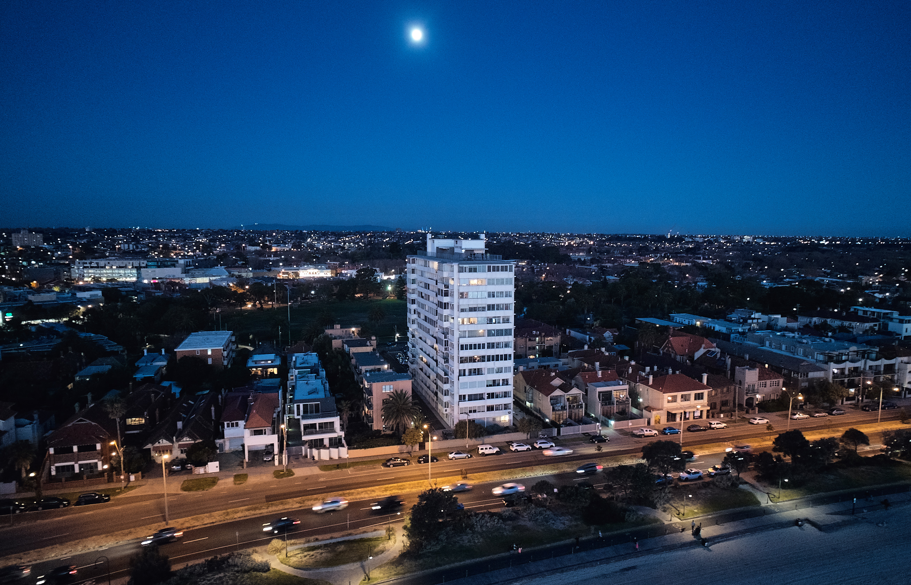
2024 Annual General Meeting
Registration of Attendance
Image Credit: Peter Bennetts – with permission

Slide 2
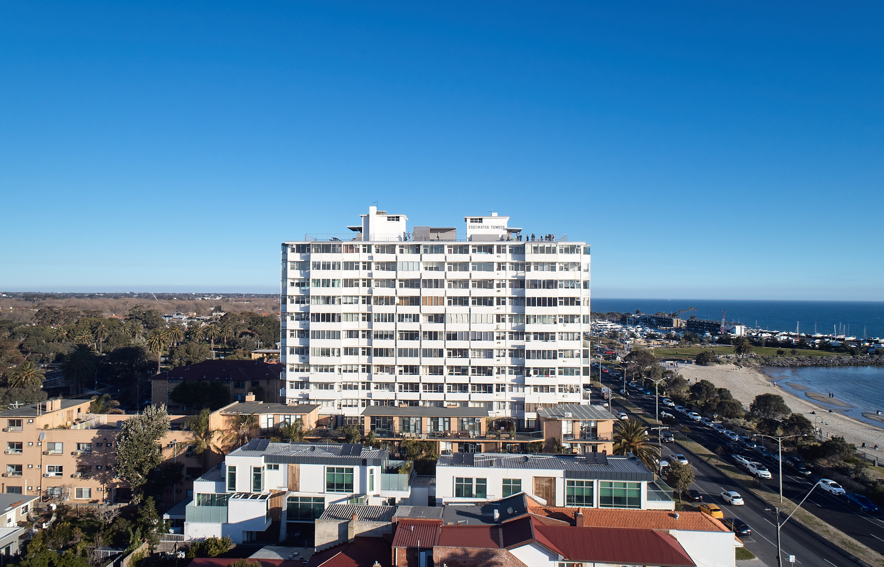
2. Voting Procedure
Image Credit: Peter Bennetts – with permission

Slide 3
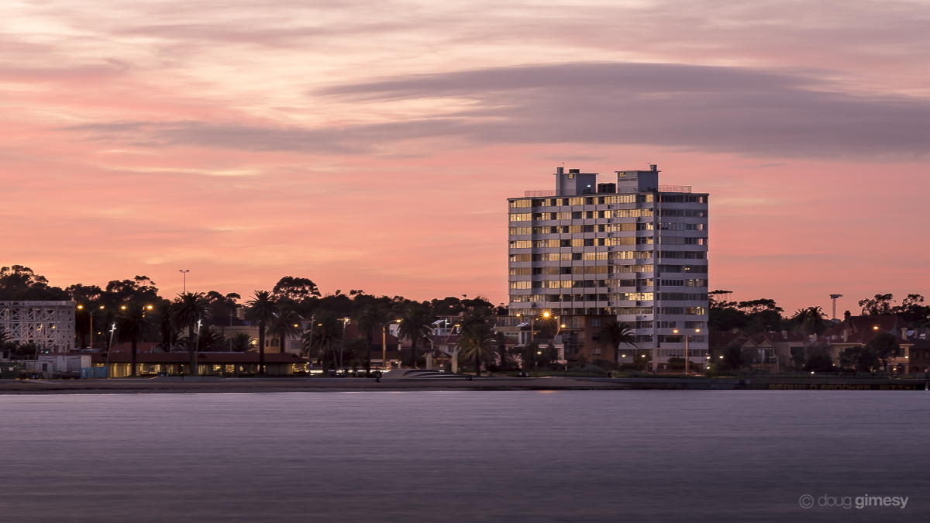
3. Adoption of Meeting Rules
Image Credit: Doug Gimesy Conservation and Wildlife Photography

Slide 4
4. Appointment of Chair
Image Credit: Peter Bennetts – with permission

Slide 5
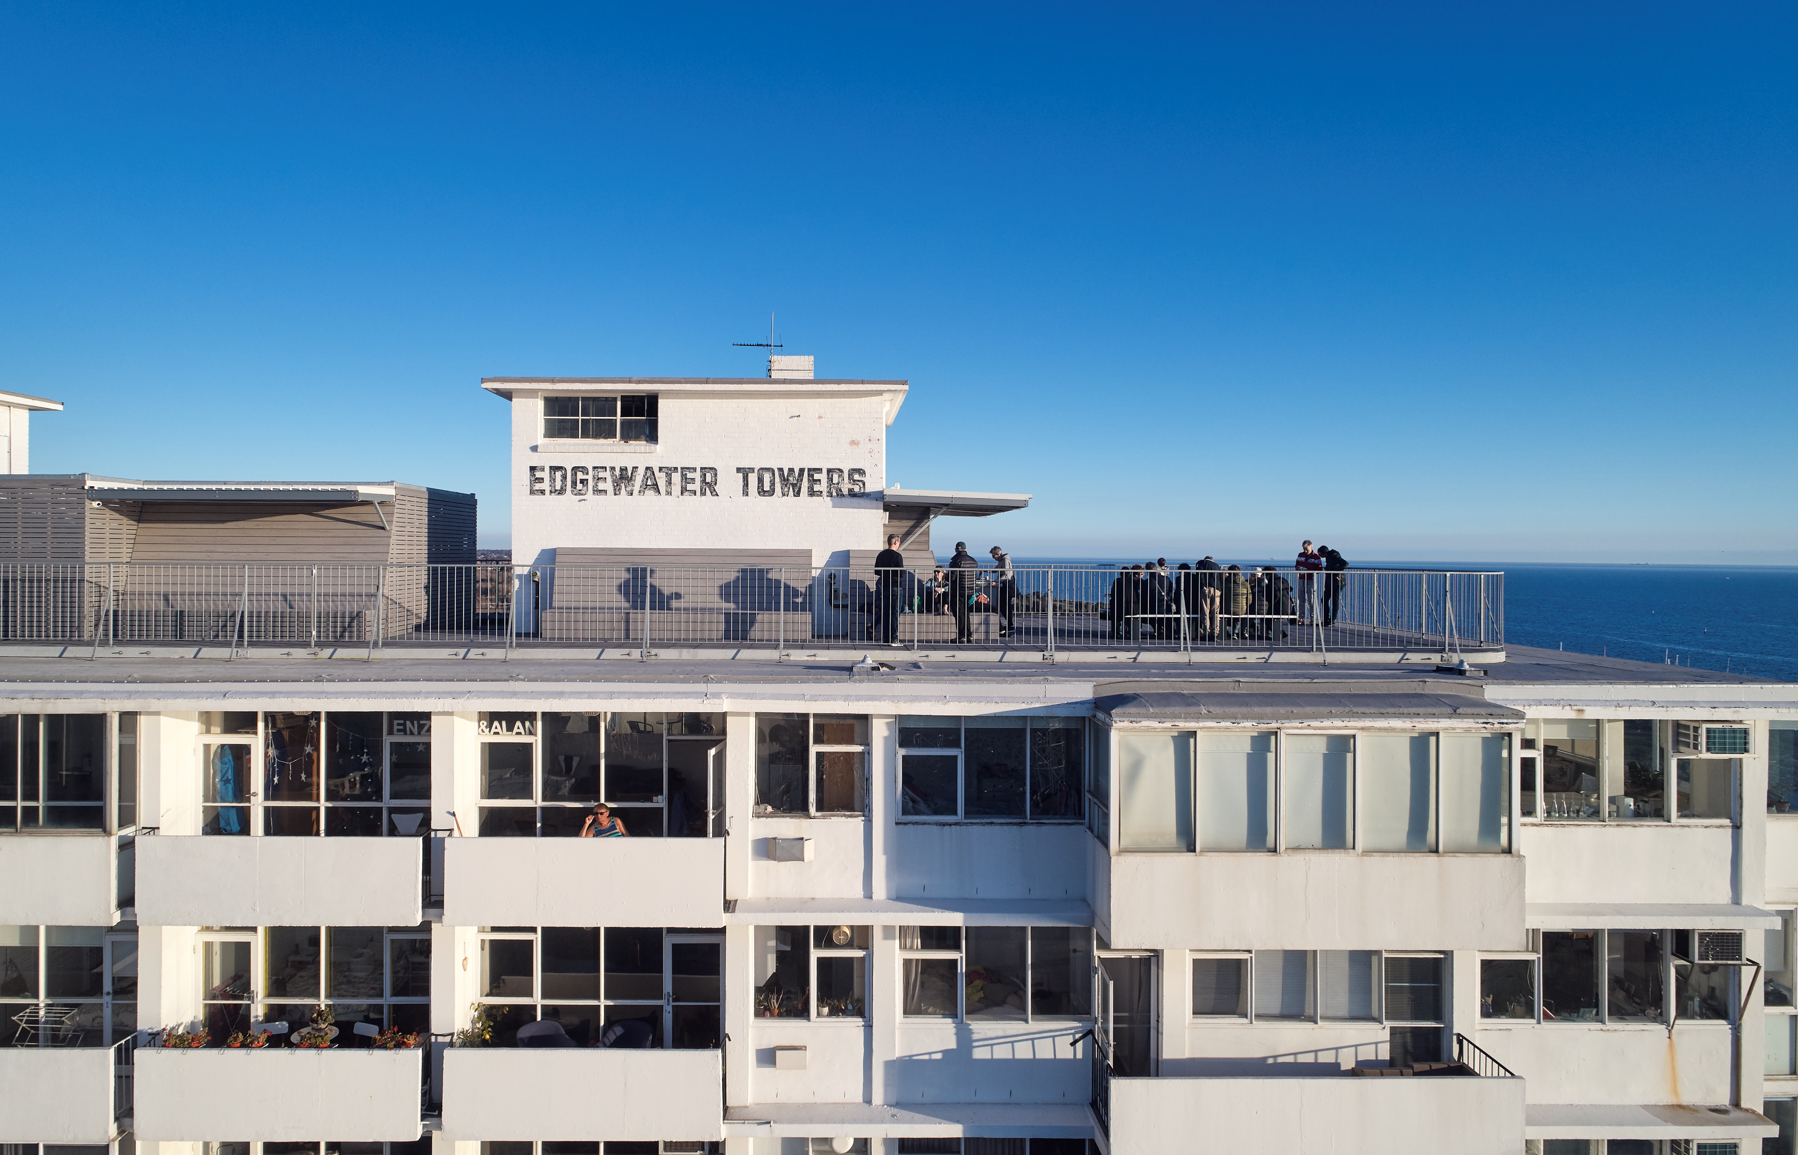
5. Minutes of Previous AGM
Image Credit: Peter Bennetts – with permission

Slide 6
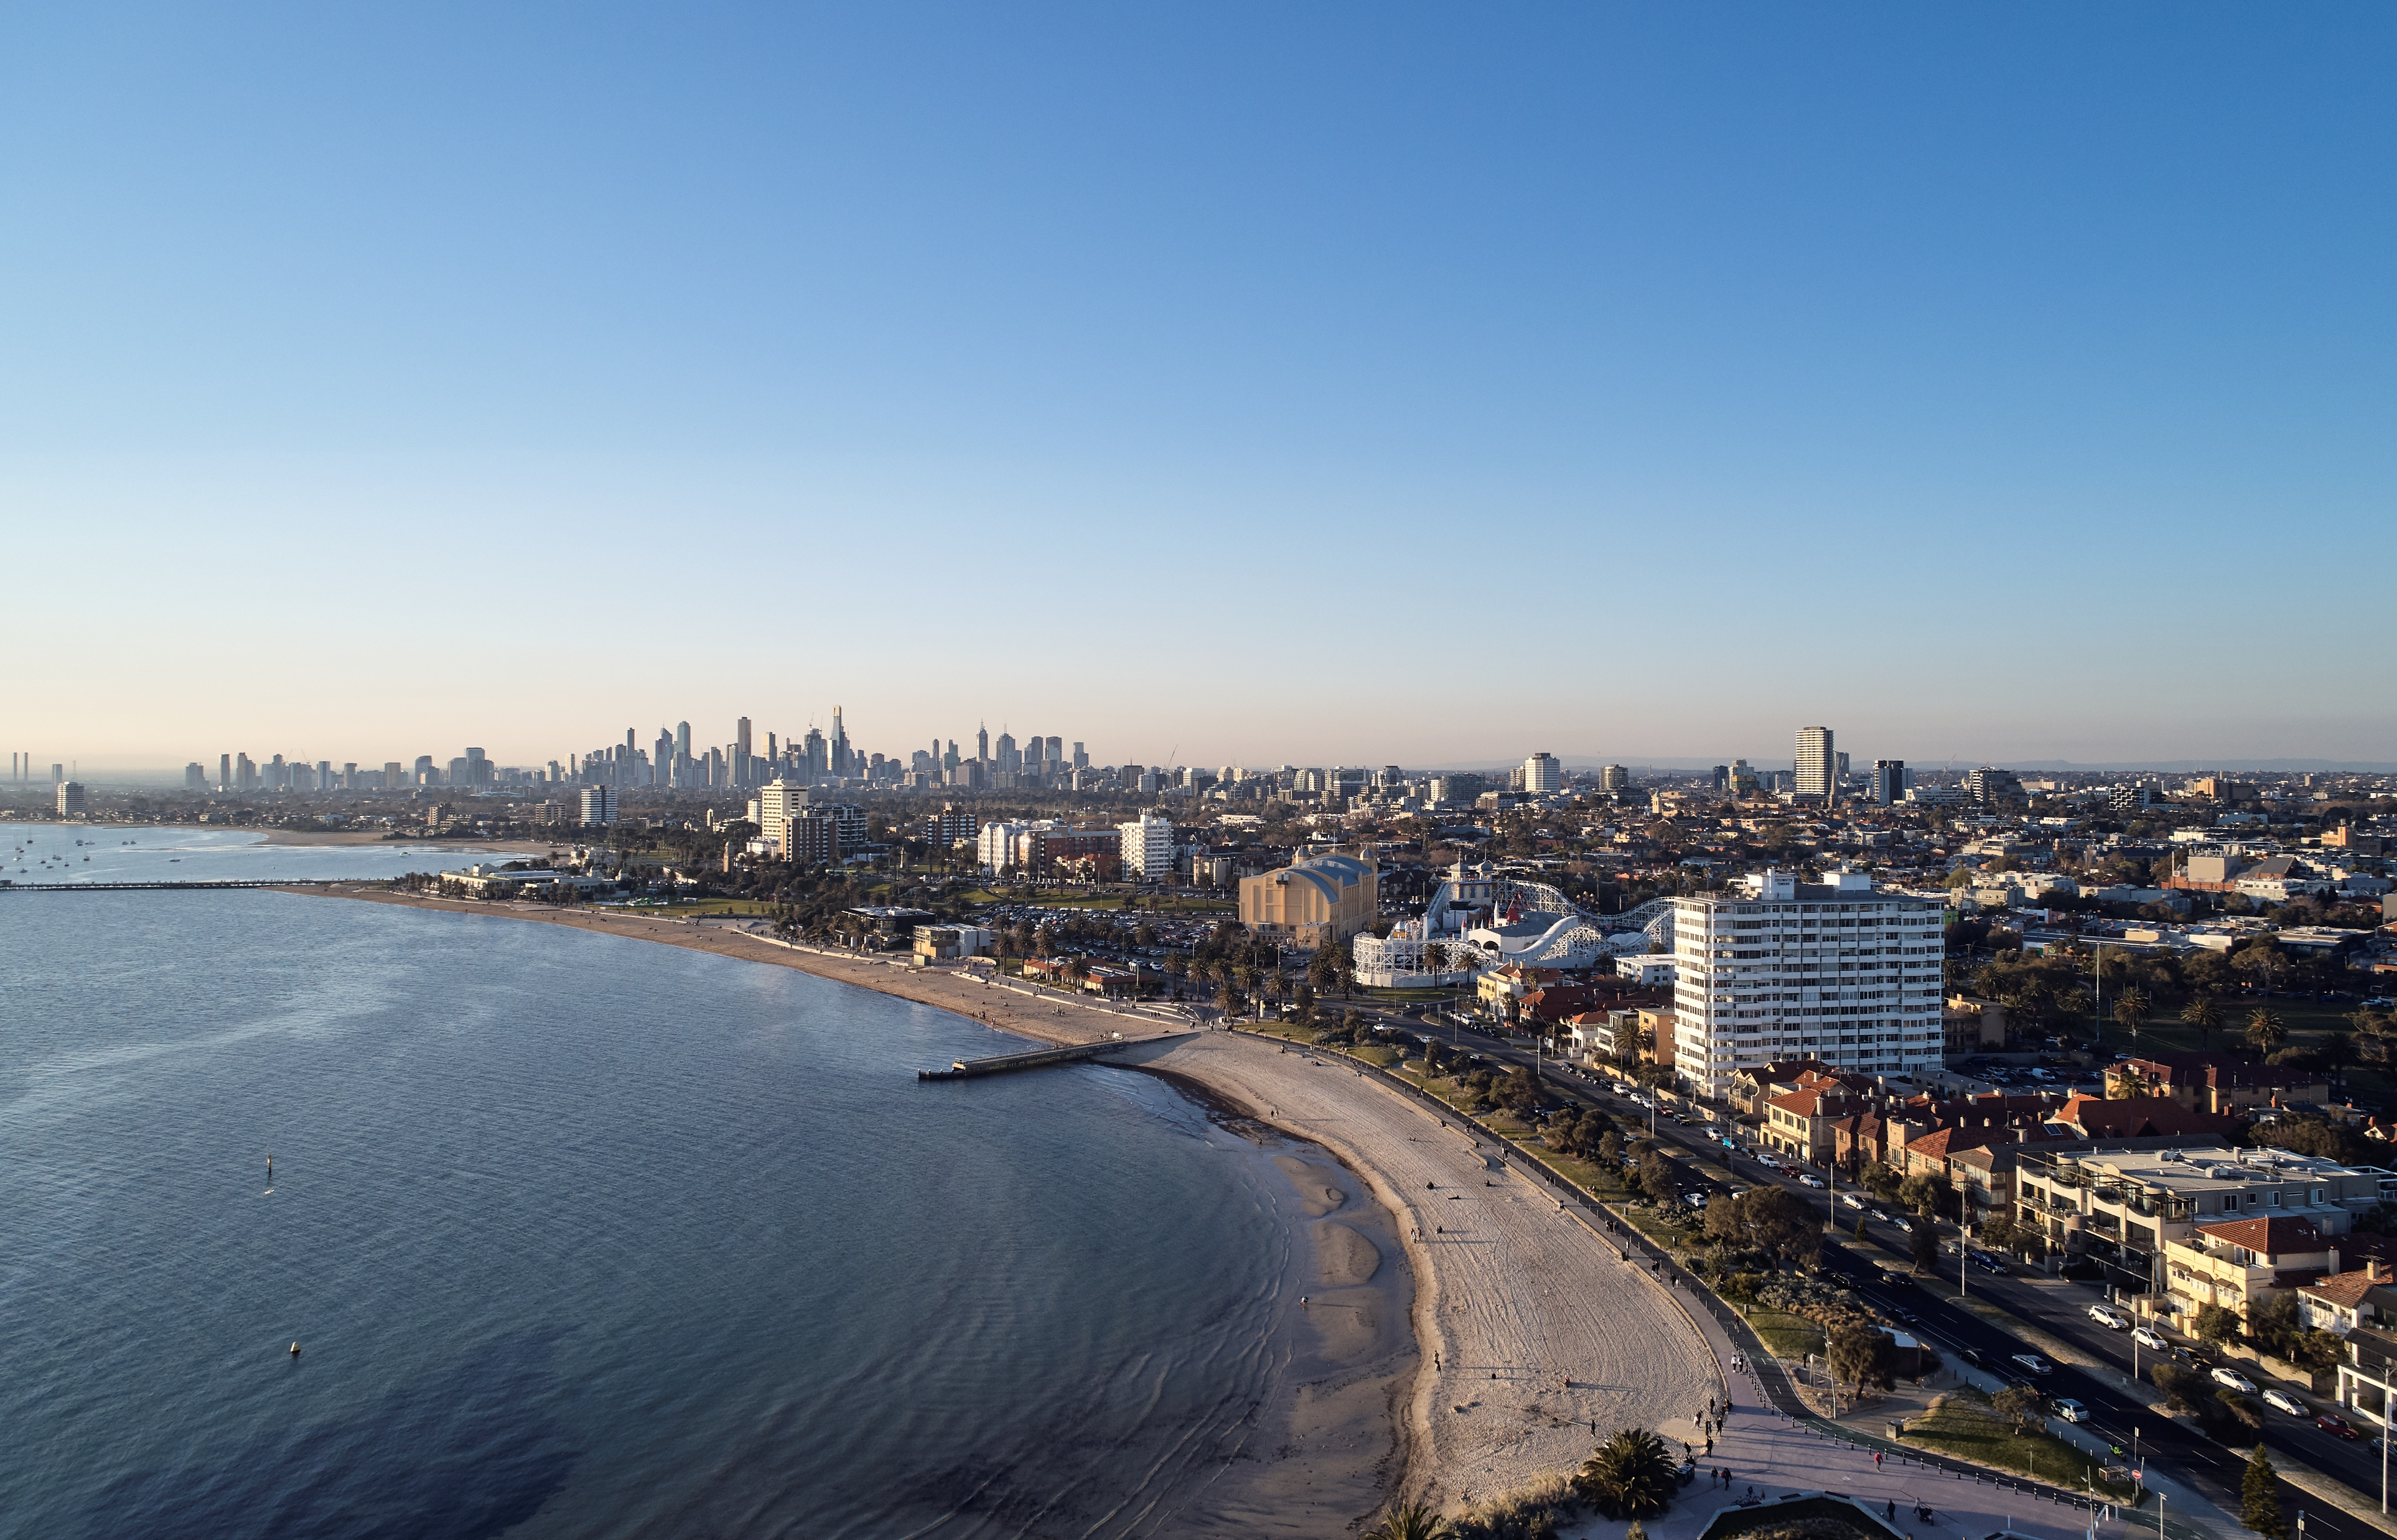
6. OC Chair’s Report
Image Credit: Peter Bennetts – with permission

Slide 7
Lift Project Completion
West lift completed December 2023
East lift completed July 2024
Increased speed from 0.8 to 1.75m/s
Increased capacity from 1000kg 13 person to 1150kg 15 person
Disability Discrimination Act 1992 (DDA) compliant for all abilities with wider lift opening doors increased from 820mm to 900mm
All residents disrupted and we particularly thank residents that gave up their car spaces during the works.

Slide 8
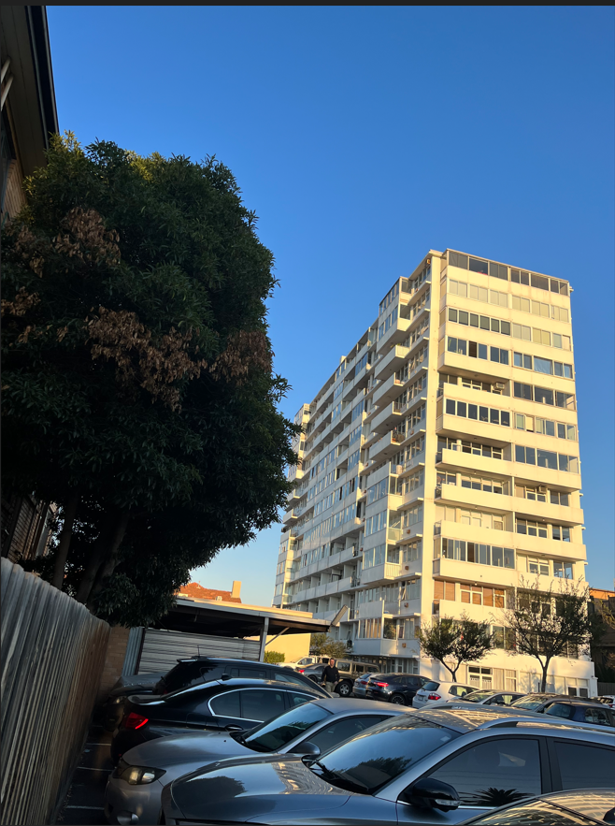
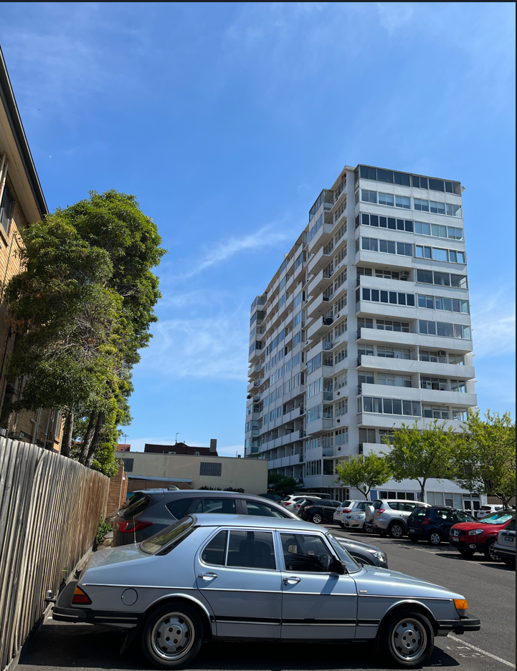
Trees Maintenance
Before
After

Slide 9
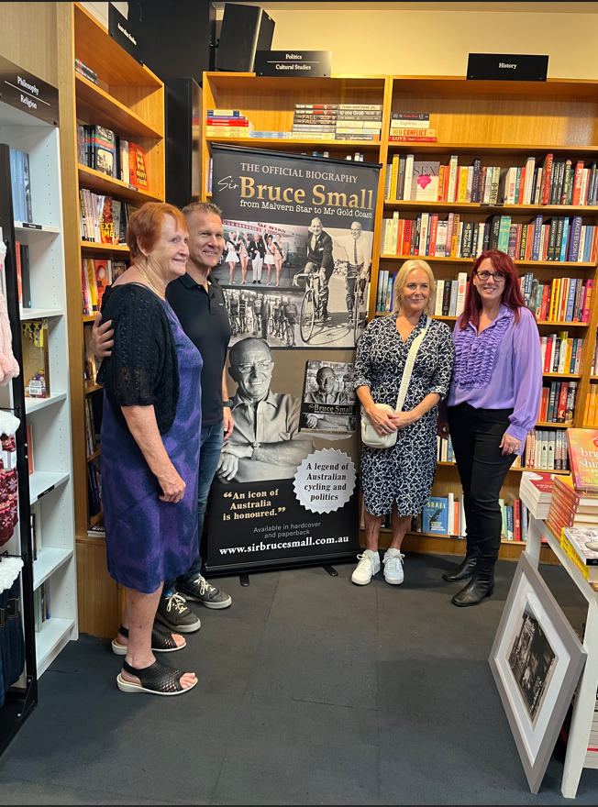
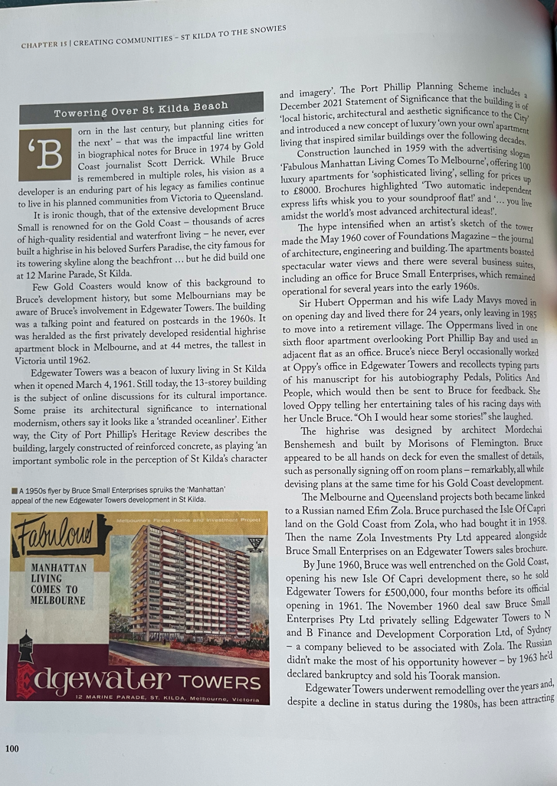
Edgewater Towers Developer Bruce Small Biography – P100
Book launch 13th March 2024 at Readings
Far Left: Granddaughter Anne Small
Far Right: Author Rachel Syers

Slide 10
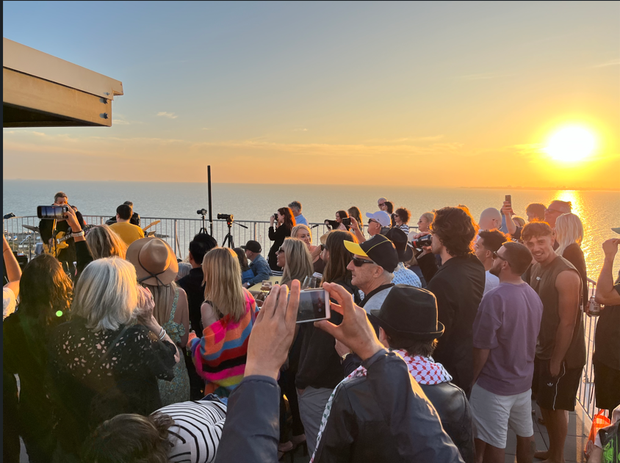
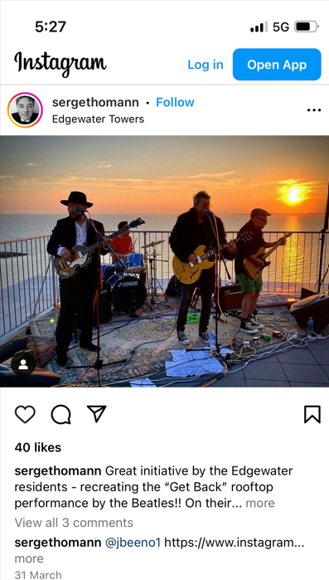
Resident musician and friends recreated the Abbey Road Beatles rooftop performance on the Edgewater rooftop.
“A great initiative!”
Rooftop gig 31st March 2024

Slide 11
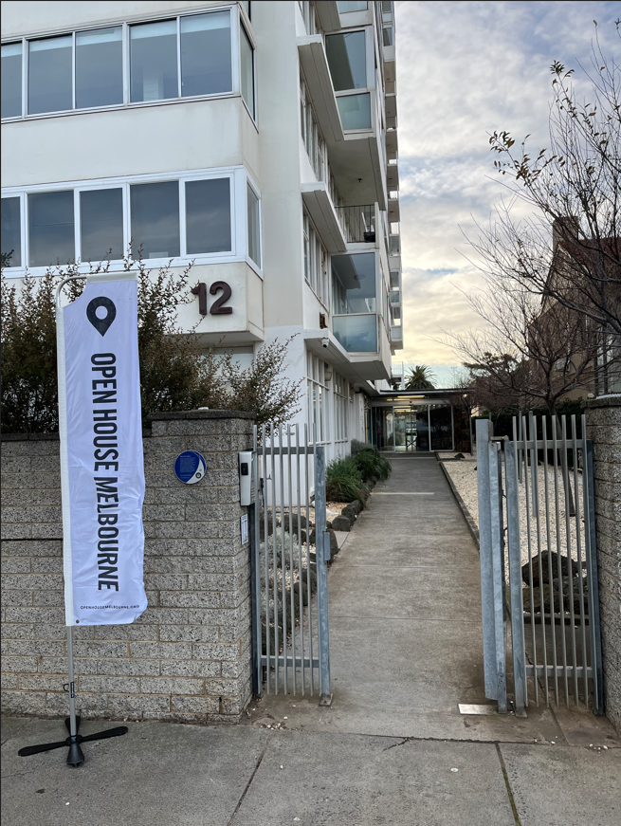
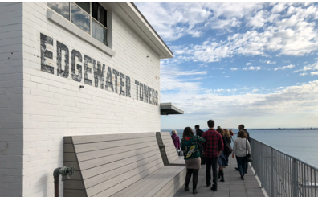
8th Open House Melbourne
27th July 2024
165 visitors on the day!
Thank you volunteer residents

Slide 12
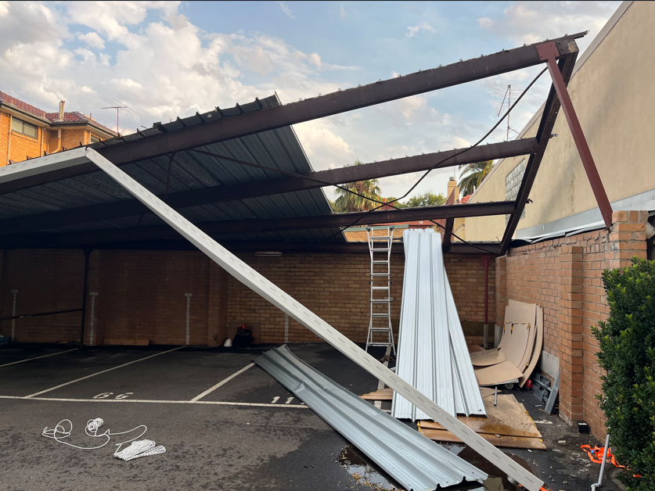
CARPORT ANGST

Slide 13
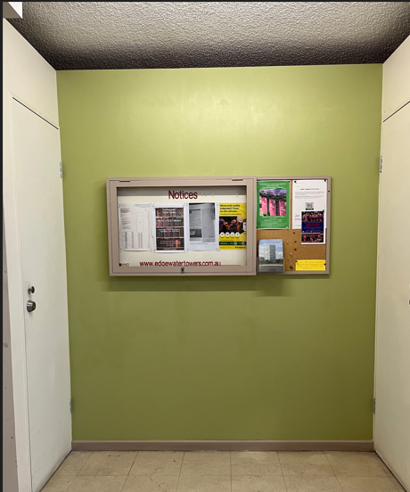
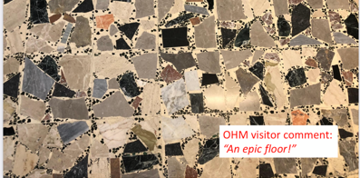
Planned Lobby Refresh
Repainting of lobby
(keep same “USA Chalk” colour?
or introduce some colour? Green?)
Repainting of lower stair wells
Terrazzo resurfacing

Slide 14
Planned façade repaint and window refurbishment
Infracorr Consulting engaged 2023 to complete façade inspections, testing and consultancy advice.
Hellier McFarland engaged to provide an interpretation of boundaries.
Final project scope of works to be confirmed early 2025 based on abseiled & drone inspections.
Legal advice to be formalised in relation to cost allocation - unit entitlement or benefit principle.
Funding options investigated providing flexibility for owners.
Develop Tender documentation for pricing 2025
Tendering of the works planned 2025
Engagement with residents on the returned Tender pricing (cost for individual owner & OC)
Contract award 2025
Works starting from late 2025
Works completing 2026-2027

Slide 15
6. Greening Working Group Report
Image Credit: Peter Bennetts – with permission

Slide 16
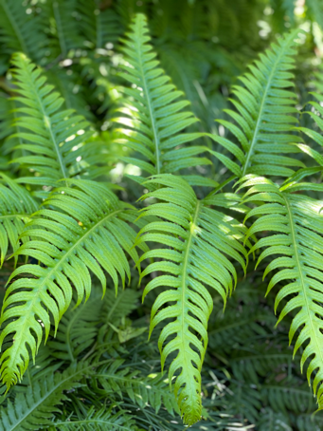
Meeting together most months in 2023/24 Current members: Marg Wilson, Susan Kohn, Gabrielle Townsend, Jenny Delahunt, Don Townsend, Di Kilsby (now absent overseas from 9/22), Alyson Campbell, Karen Reid, Dana Morfett & Russell Jessop. New members welcome!
Greening Working Group

Slide 17
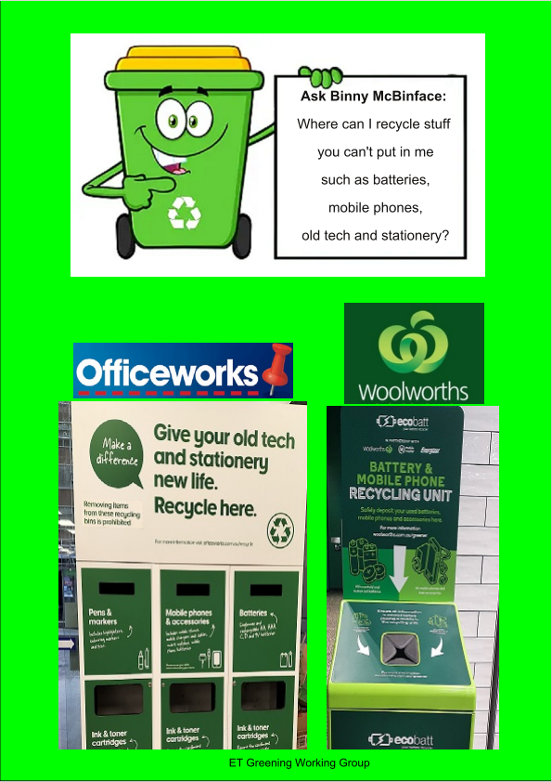
Recycling information
Regular posters on recycling
Please use recycling bins correctly!

Slide 18
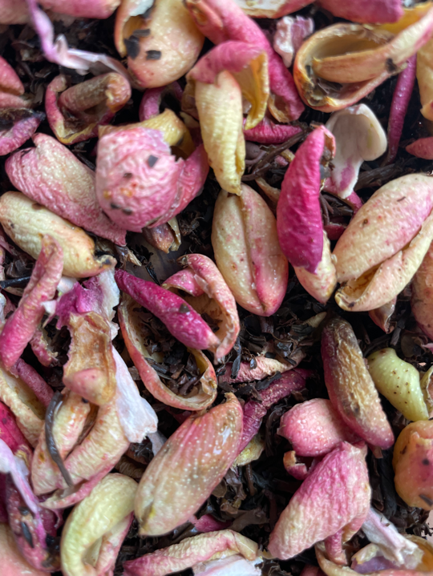
Reducing our food waste
We can divert roughly 100-140kg of organic waste per month
Waste caddies available on request from Greening Working Group
Please compost: help reduce our carbon footprint!

Slide 19
Facilitating recycling
Collection of empty toothpaste and dental floss containers
Started January 2022 – very successful!
Box in lobby last weekend of each month.

Slide 20
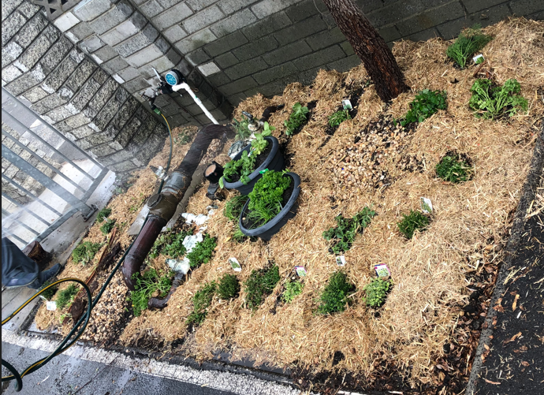
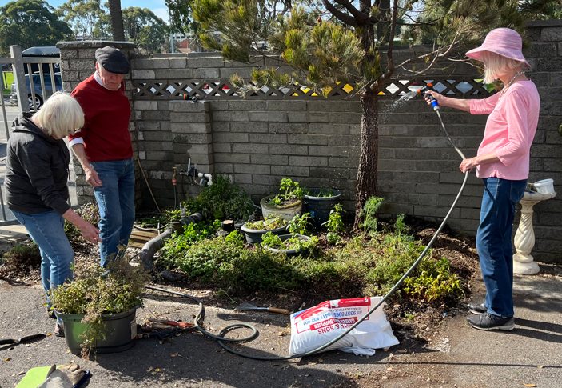
Herb garden
2nd herb replanting working bee Sunday 24th April 2024
Thanks to volunteer residents on the day.
Monthly working bees to maintain.
3/4/22
28/4/24

Slide 21
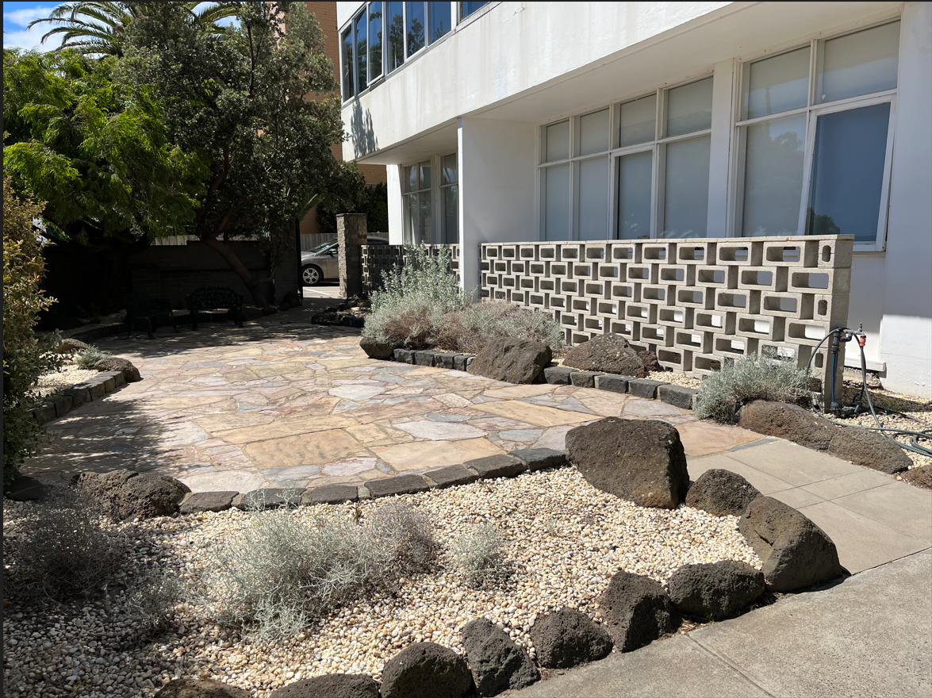
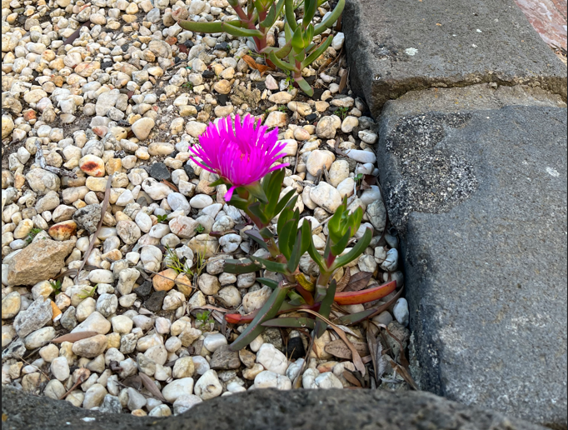
Indigenous gardens
We continue to propagate and replace plantings in the extreme windy conditions
Improving survival rate!

Slide 22
Edgewater Towers – Water Consumption 2023
Year | 2016 | 2017 | 2018 | 2019 | 2020 | 2021 | 2022 | 2023
Water Use (KL)* | 8971 | 7581 | 6732 | 6473 | 6447 | 5140 | 4894 | 4727
Improvement (%) from base 2016 | Baseline | 15.4 | 24.9 | 27.8 | 28.1 | 42.7 | 45.4 | 47.3
Improvement (%) year on year | Baseline | 15.4 | 11.1 | 3.8 | 0.4 | 20.2 | 5.0 | 3.4
*Southeast water billing unit 3A*101units = building total
9000
8000
7000
6000
5000
4000
Downward trend in water use
Building use (KL)
2016 2017 2018 2019 2020 2021 2022 2023
Year

Slide 23
Edgewater Towers – Electricity Consumption 2023
Year | 2018 | 2019 | 2020 | 2021 | 2022 | 2023
Elec Use (kWh)* | 78,736 | 74,575 | 85,887 | 83,323 | 80,726 | 75,352
Improvement (%) from base 2018 | Baseline | 5% | (9%) | (6%) | (3%) | 4%
Improvement (%) year on year | Baseline | 5% | (15%) | 3% | 3% | 6%
Based on 0.96 emission factor 2022-23 is Approx. 72.3 Tonnes carbon dioxide equivalent. Reduction of 5 Tonnes on 2021-22.
90,000
85,000
80,000
75,000
70,000
Building use (kWh)
2018 2019 2020 2021 2022 2023
Year
*Common areas energy (lighting, WC ventilation fans, lifts, laundries, BBQs & cleaner’s water heater)

Slide 24
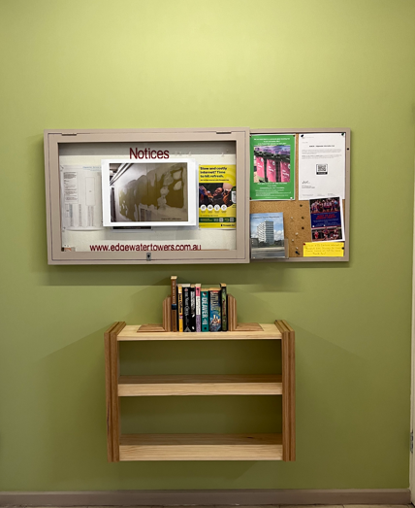
Little Library “Nook”
Recycle books, magazines and CDs.
Fabricated from left-over remnants of profiled Edgewater timber
Installed 24 July 2024
Designed and fabricated by resident Richard Manning – Thank you!

Slide 25
Nature Strip
New City Port Phillip Nature Strip Guidelines August 22
Aim: elimination of grass (no mowing maintenance)
Indigenous plantings proposed
2023 AGM Presentation Slide

Slide 26
Edgewater Towers – Marine Parade Nature Strip Plan
EXISTING PARKING
Proposed prototype planting in 2025 in the area of this red box
EXISTING SIDEWALK
LEGEND:
GROUND COVER NEW INDIGENOUS PLANTS TO 0.5m H EXTG. STREET TREE
(NOT GRASS)

Slide 27
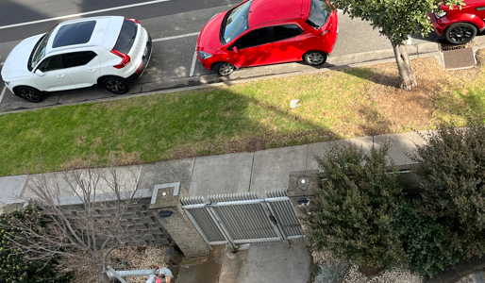
PROTOTYPE PLANTING AREA

Slide 28
Prototype has the following advantages:
Promotes the Edgewater Towers sustainability agenda.
Turns our nature strip into an indigenous wildlife sanctuary for pollinating insects.
Compliments the existing indigenous foreshore planting species.
Is limited to only Approx. 20% of the nature strip so is a minimum approach.
Maximises planting opportunity immediately at Marine Parade Gate address/point of entry.
The current monthly sprinkler water testing will irrigate naturally.
Will allow a test period (1-2 years) to see if it is possible to eliminate the deep grass roots and demonstrate the success or otherwise of the ground cover.
Prototype plantings can be used to propagate for later use.
Allows a good period of time for resident feedback.
If the prototype plantings fail or fails to gain positive feedback traction it is easily reverted.

Slide 29
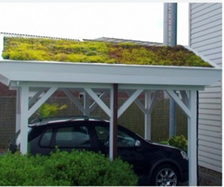
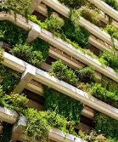
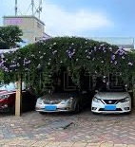
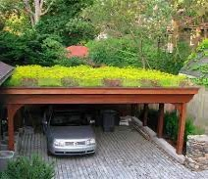
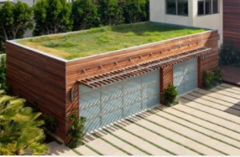
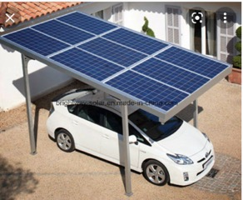
FUTURE VISION
Events!
We want your ideas!
Conversations
Fun!
PLEASE JOIN IN!

Slide 30
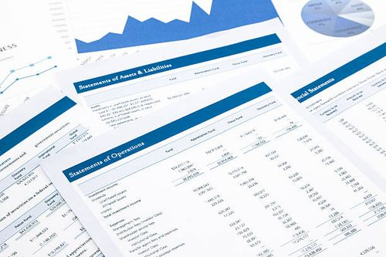
7 - 9. Financial Statements and Budgets

Slide 31
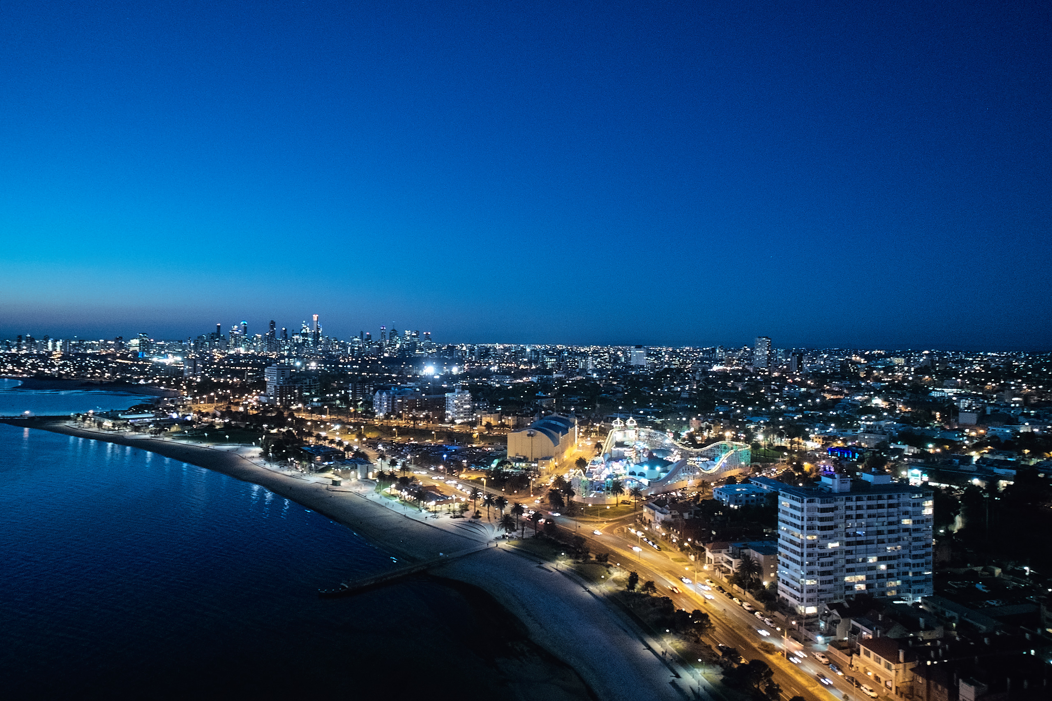
10 - 12. Various Admin Matters
Image Credit: Peter Bennetts – with permission

Slide 32
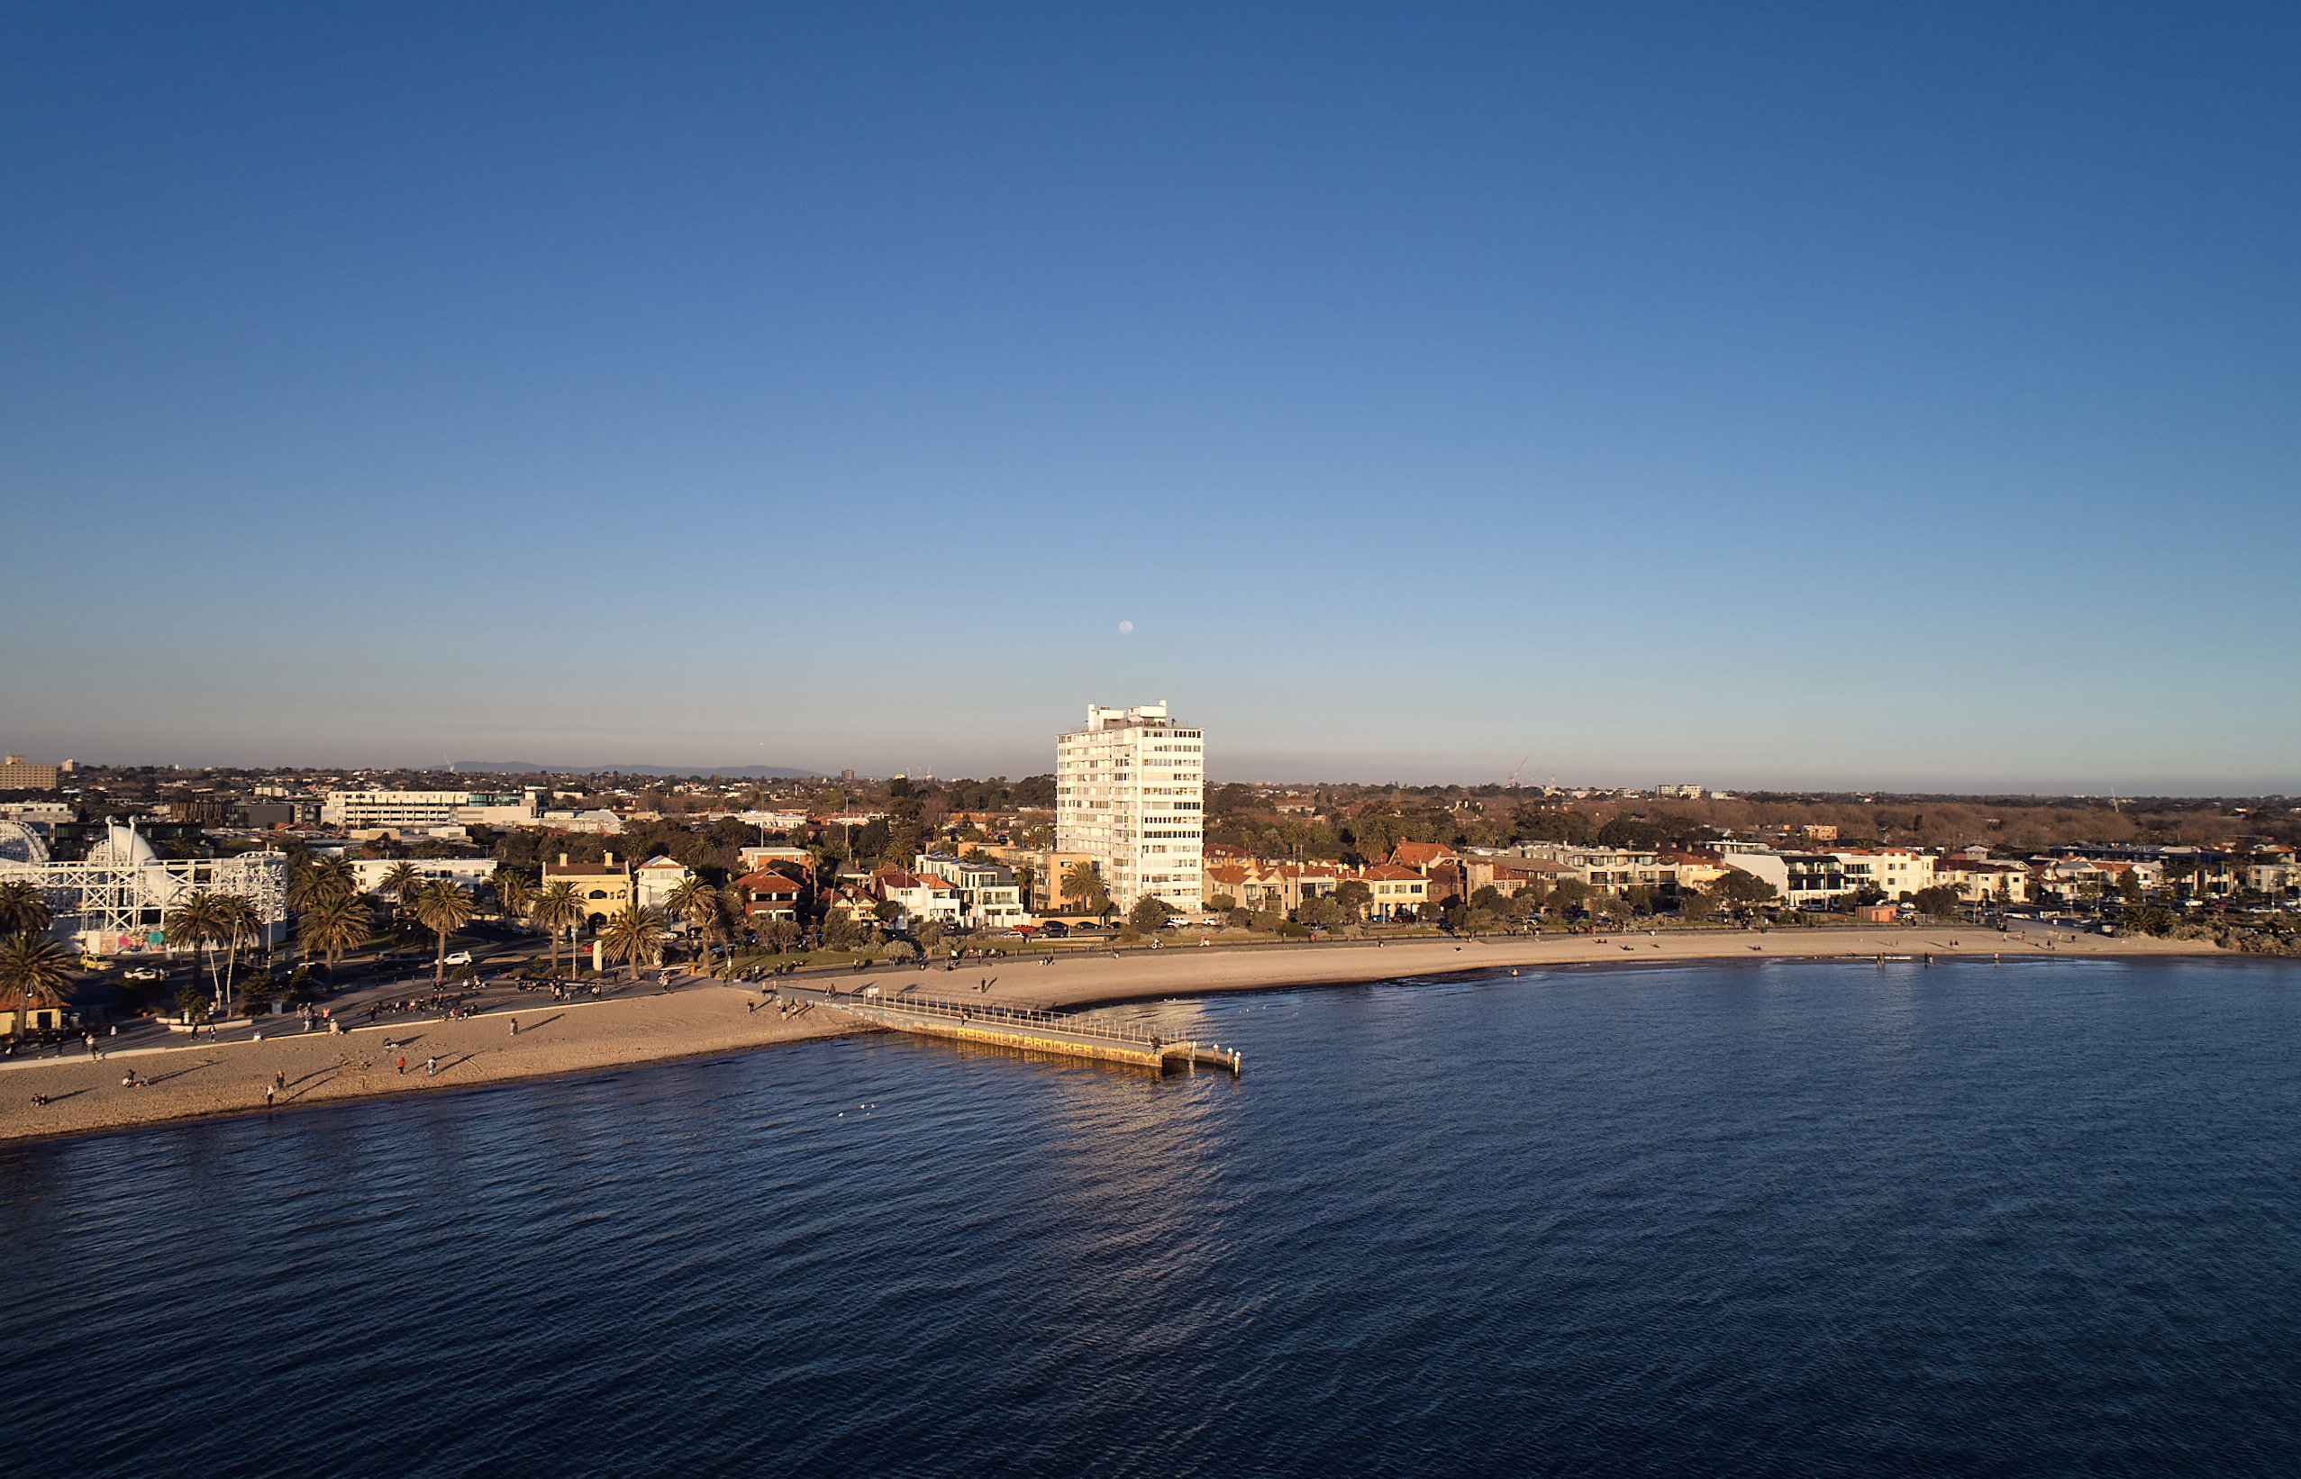
13. OC Committee
Image Credit: Peter Bennetts – with permission

Slide 33
Current Committee
Andrew Hackworth
John Van Der Laan
Mark Brickles
Michael Cass
Morgan Adams
Russell Jessop
Sym Kohn

Slide 34
14. Appointment of Manager
We are contracted with Tideways until November 2026
Image Credit: Peter Bennetts – with permission

Slide 35
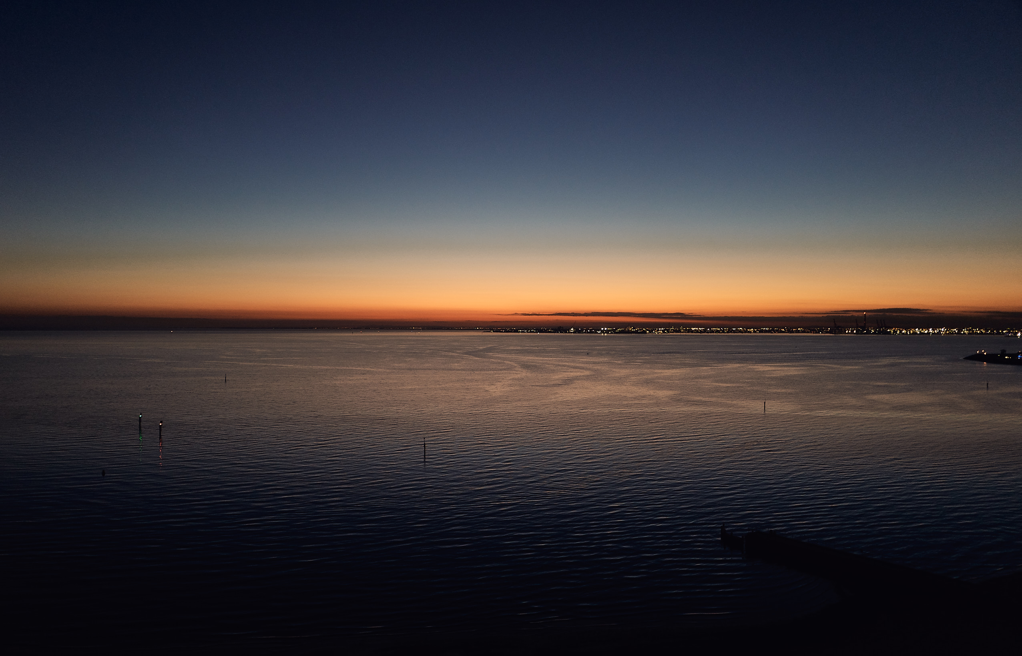
15. General Business
Image Credit: Peter Bennetts – with permission

