Slide 1
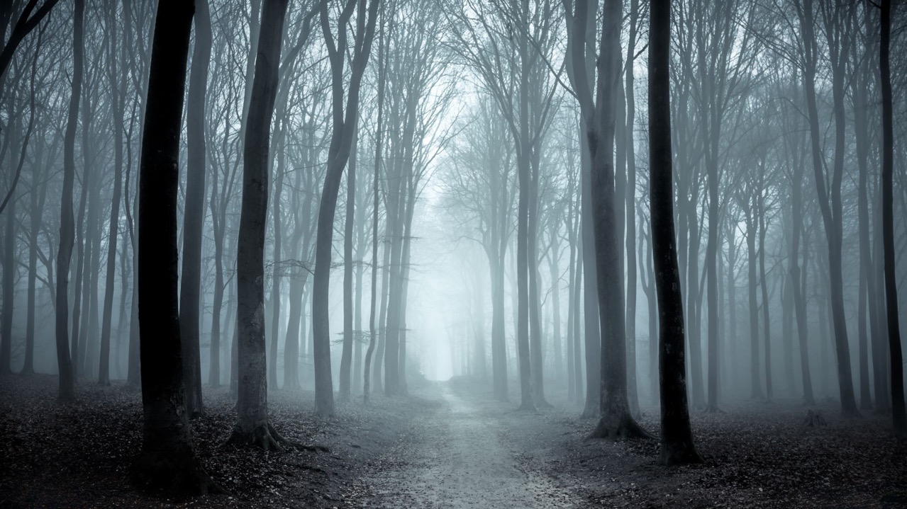
Edgewater Towers Greening Working Group
Progress Report No.3 October 2023

Slide 2
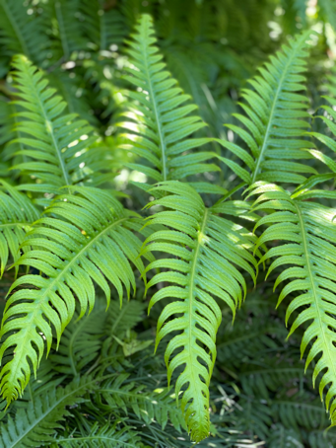
Meeting together most months in 2022/23 Current members: Marg Wilson, Susan Kohn, Gabrielle Townsend, Jenny Delahunt, Don Townsend, Di Kilsby (now absent overseas from 9/22), Alyson Campbell, Russell Jessop. Thanks to past member Lainie Cann. New members welcome!
Greening Working Group

Slide 3
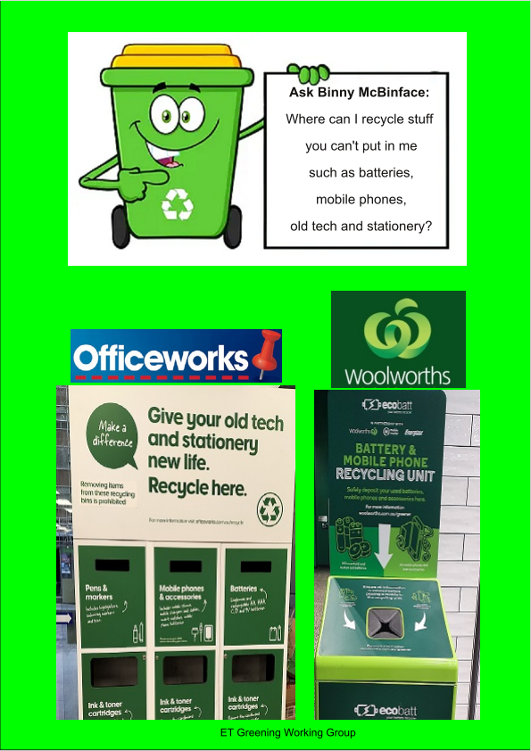
Recycling information
Regular posters on recycling
Please use recycling bins correctly!

Slide 4
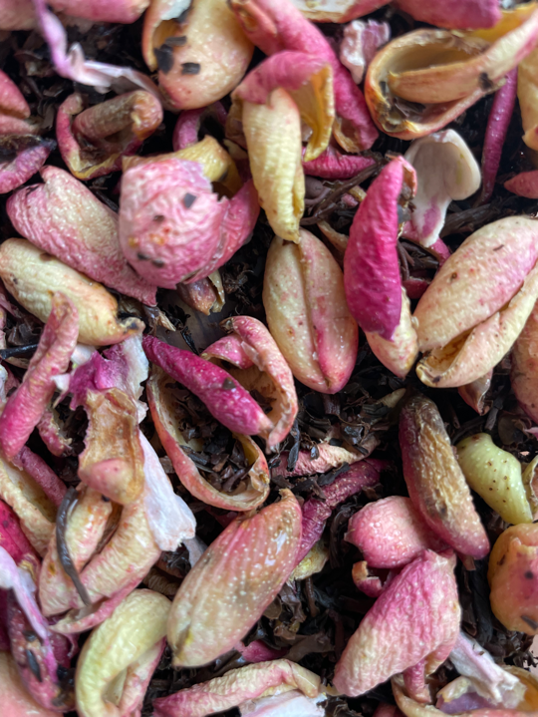
Reducing our food waste
We can divert roughly 100-140kg of organic waste per month
Waste caddies available on request from Greening Working Group
Please compost: help reduce our carbon footprint!

Slide 5
Facilitating recycling
Collection of empty toothpaste and dental floss containers
Started January 2022 – very successful!
Box in lobby last weekend of each month.

Slide 6
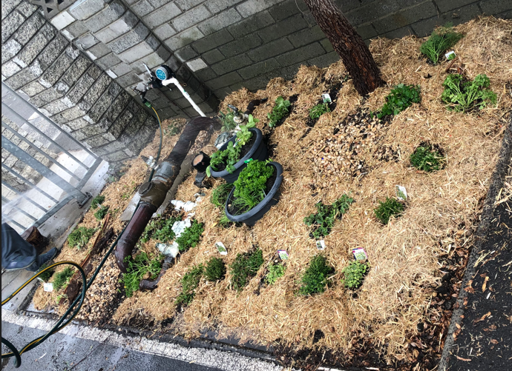
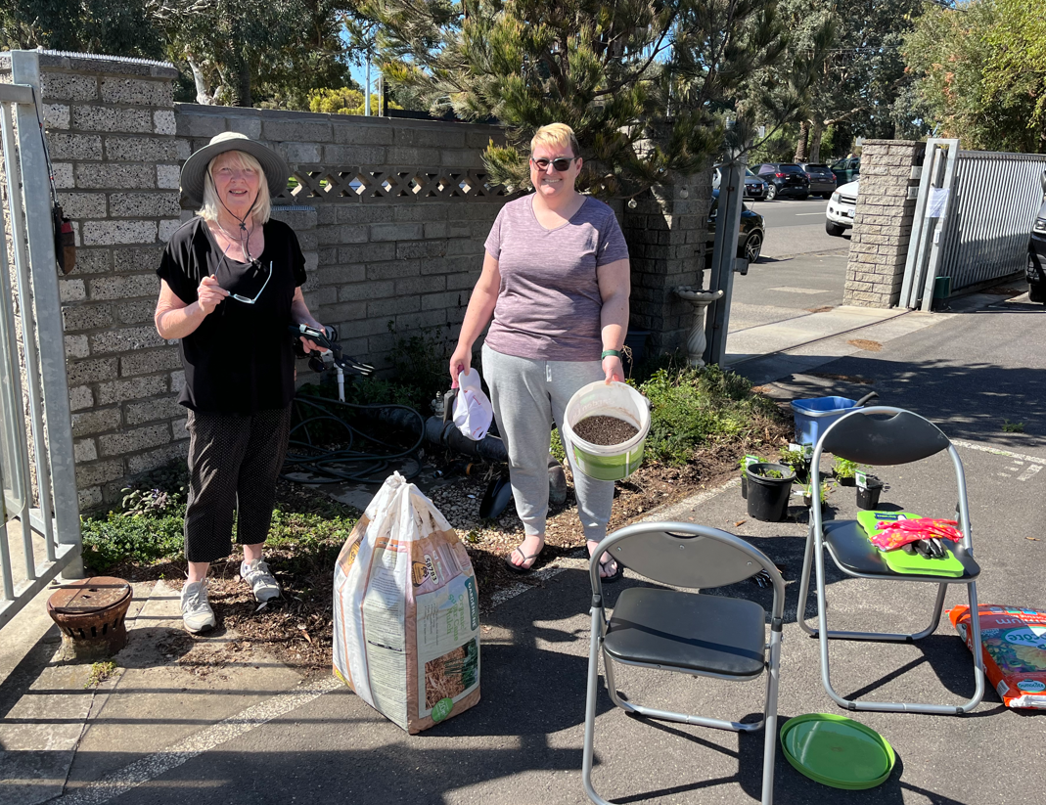
Herb garden
Replanting working bee Sunday 24th September 2023
Thanks to volunteer residents on the day
3/4/22
24/10/22

Slide 7
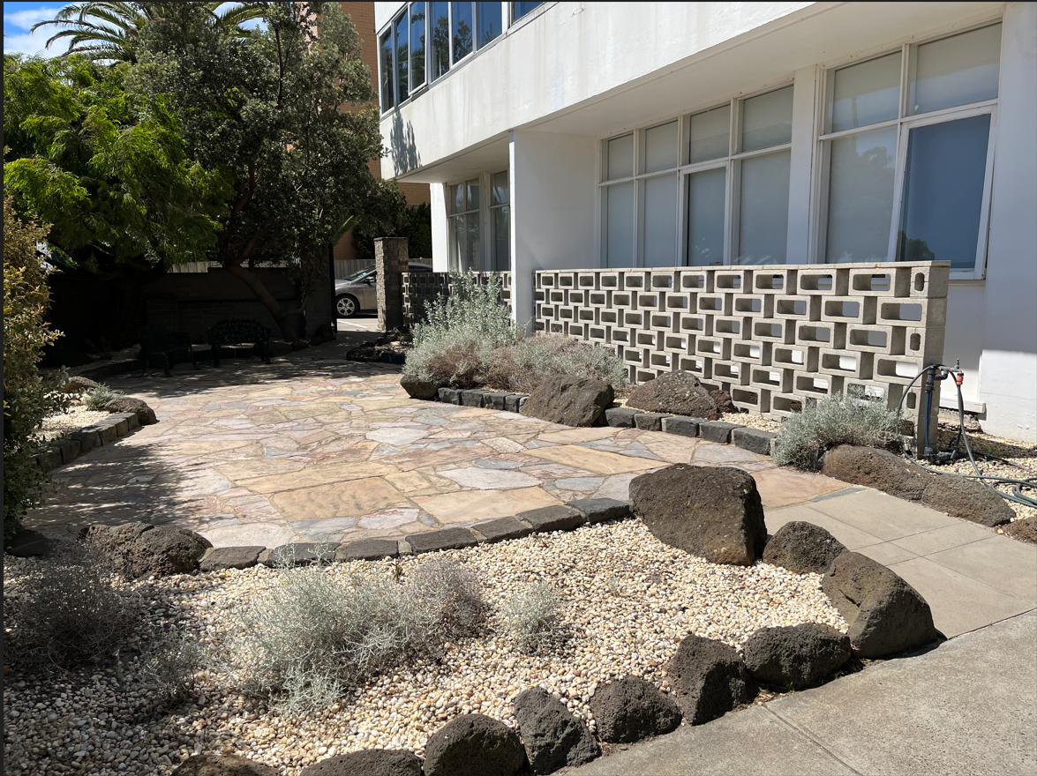
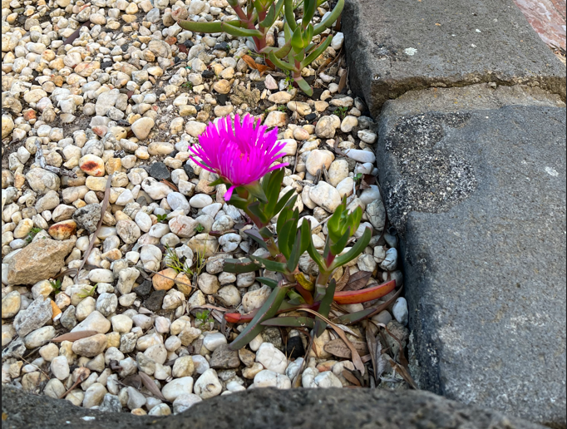
Indigenous gardens
We continue to propagate and replace plantings in the extreme windy conditions
We cleaned the ’60s patio paving reducing mould.
Approx. 50% plantings survival rate!

Slide 8
Edgewater Towers – Water Consumption 2022
Year | 2016 | 2017 | 2018 | 2019 | 2020 | 2021 | 2022
Water Use (KL)* | 8971 | 7581 | 6732 | 6473 | 6447 | 5140 | 4894
Improvement (%) from base 2016 | Baseline | 15.4 | 24.9 | 27.8 | 28.1 | 42.7 | 45.4
Improvement (%) year on year | Baseline | 15.4 | 11.1 | 3.8 | 0.4 | 20.2 | 5.0
*Southeast water billing unit 3A*101units = building total
9000
8000
7000
6000
5000
4000
Downward trend in water use
Building use (KL)
2016 2017 2018 2019 2020 2021 2022
Year

Slide 9
Edgewater Towers – Electricity Consumption 2022
Year | 2018 | 2019 | 2020 | 2021 | 2022
Elec Use (kWh)* | 78,736 | 74,575 | 85,887 | 83,323 | 80,726
Improvement (%) from base 2018 | Baseline | 5% | (9%) | (6%) | (3%)
Improvement (%) year on year | Baseline | 5% | (15%) | 3% | 3%
Based on 0.96 emission factor 2021-22 is Approx. 78 Tonnes carbon dioxide equivalent. Reduction of 4Tonnes on 2020-21.
90,000
85,000
80,000
75,000
70,000
Building use (kWh)
2018 2019 2020 2021 2022
Year
*Common areas energy (lighting, WC ventilation fans, lifts, laundries, BBQs & cleaner’s water heater)

Slide 10
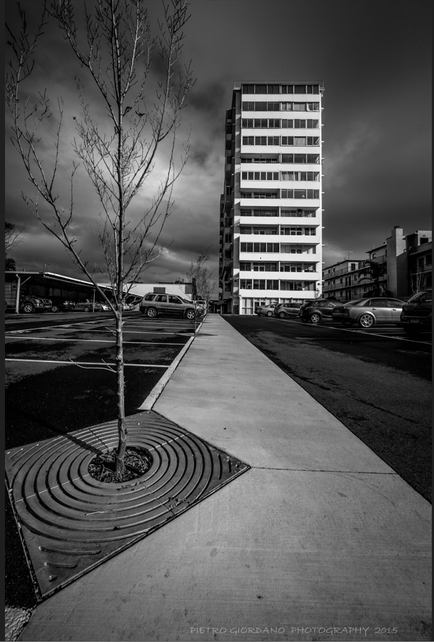
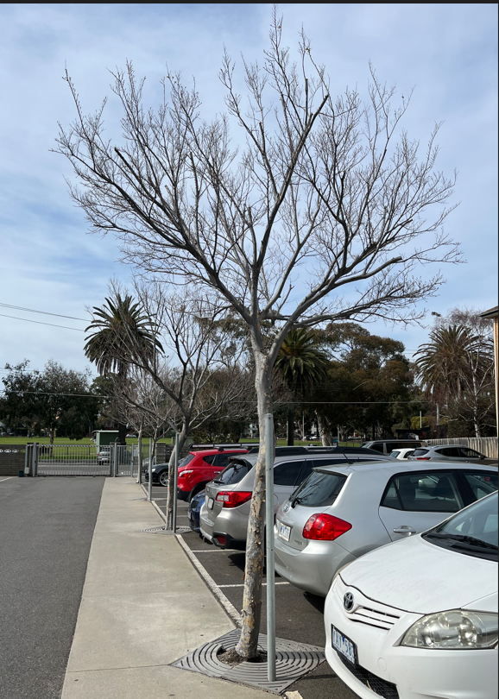
Trees
5 year formative pruning of the 20 Chinese Elms
Planted 2013
Absorb carbon dioxide, provide shade, reduce heat-island effect and ameliorate the wind
Image credit: Pietro Giordano 2015 27/8/23

Slide 11
Nature Strip
New City Port Phillip Nature Strip Guidelines August 22
Aim: elimination of grass (no mowing maintenance)
Indigenous plantings proposed

Slide 12
Edgewater Towers – Marine Parade Nature Strip Plan
EXISTING PARKING
EXISTING SIDEWALK
LEGEND:
GROUND COVER NEW INDIGENOUS PLANTS TO 0.5m H EXTG. STREET TREE
(NOT GRASS)

Slide 13
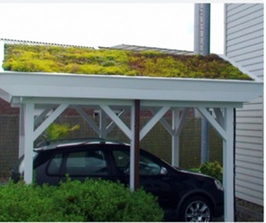
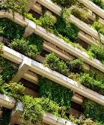
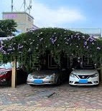
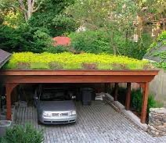
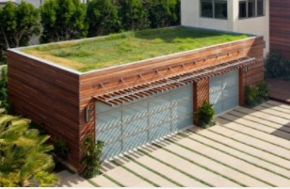
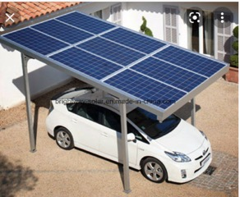
FUTURE VISION
Events!
Electric Vehicles - No EV solution!
We want your ideas!
Conversations
Fun!
PLEASE JOIN IN!

